Slide 1

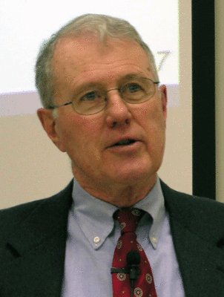
Major Prophets
Lecture 27: Ezekiel 36-37 – Dry Bones and Two Sticks, Prophecy/Fulfillment
Dr. Robert Vannoy
ReNarrated by Dr. Perry Phillips
© 2023 Robert Vannoy & Ted Hildebrandt

Slide 2
Major Prophets
Ezekiel 33 – Jerusalem Has Fallen
Selected Passages from Ezek. 36 in Context (Restoration)
Beyond the Return from Exile—Church or Future Return of Israel to Its Land
Ellison – Church and New Covenant (Jer. 31-34)
Problem with the “Church” view
On Continuity and Discontinuity (Ezek. 36 & Jer. 31)
NT Use of Jer. 31 and Ezek. 36
3 Options
Ezekiel 37 Dry Bones and Sign of the 2 Sticks
Ezekiel 37:15ff – Prophecy of the 2 Sticks

Slide 3
Major Prophets
Aalders – Spiritual Approach
Ellison: Modern Israel’s Return but Spirit Still Needed
Taylor Ezek. 37 -- Messianic Kingdom of the Last Days
Alexander – Church Fulfills Many Expectations
J. B. Payne – Complex view (Divide and Conquer Approach)
Video based on audio from Dr. Vannoy’s class at Biblical Theological
Seminary. It was renarrated by Dr. Perry Phillips because the original audio
was scratchy and it was turned into video by Ted Hildebrandt for Biblicalelearning.org.

