Slide 1

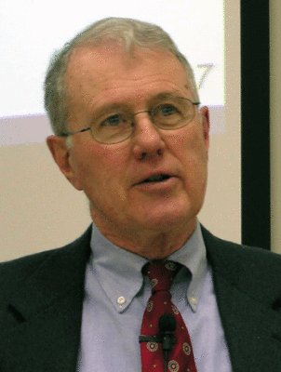
Major Prophets
Lecture 16: Servant of the Lord Theme Continued
Dr. Robert Vannoy
ReNarrated by Dr. Perry Phillips
© 2023 Robert Vannoy & Ted Hildebrandt

Slide 2
Major Prophets
8. Isaiah 49:1-12 Text Read-thru
General Remarks on Isaiah 49:1-9
How Can the Servant Be Both Israel and Differentiated from Israel?
Isaiah 49:1 Connection of the Servant and His Mother
Isaiah 49:2 Servant’s Effectiveness and Protection
Isaiah 49:3-4 Servant Israel Individualized
Isaiah 49:5-6 Servant Clearly Distinguished from Israel
Isaiah 49:7 Humiliation and Exaltation of the Servant
Isaiah 49:8-9 Things Beyond the Capacity of Israel to Fulfill
Isaiah 49:10-11 Blessing to Those Who Follow the Servant

Slide 3
Major Prophets
Isaiah 49:12 Worldwide Return
Summary of Isaiah 49:1-12 Servant Theme
3. Isaiah 50:4-11 Light to the Gentiles Theme
General Remarks on Isaiah 50:4-9 Individualized Servant’s Sufferings
Isaiah 50:4 Tongue of the Learned
Isaiah 50:5 Servant is Not Rebellious
Isaiah 50:6 Voluntary Suffering of the Servant
Isaiah 50:7 Set His Face Like a Flint – No Shame

Slide 4
Major Prophets
Video based on audio from Dr. Vannoy’s class at Biblical Theological
Seminary. It was renarrated by Dr. Perry Phillips because the original audio
was scratchy and it was turned into video by Ted Hildebrandt for Biblicalelearning.org.

