Slide 1

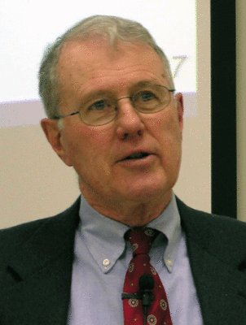
Major Prophets
Lecture 2: Isaiah 1:1-2:4
Dr. Robert Vannoy
ReNarrated by Dr. Perry Phillips
© 2023 Robert Vannoy & Ted Hildebrandt

Slide 2
Major Prophets
C. The Structure of the Book of Isaiah
1. Isaiah 1-6 Judgment and Blessing
Isaiah 1 – Indictment and Deuteronomy – Isaiah 1:1-2
Isaiah 1:4-18
Isaiah 1:18-20 Appeal to Reason Together
Blessing
Isaiah 2:1-5 Swords into Plowshares
Micah 4:1-5 Parallel
When Will This Take Place?
In the “last days”
“Last Days” as a Technical Term (E.J. Young) – Time between advents
amillennial position

Slide 3
Major Prophets
Video based on audio from Dr. Vannoy’s class at Biblical Theological
Seminary. It was renarrated by Dr. Perry Phillips because the original audio
was scratchy and it was turned into video by Ted Hildebrandt for Biblicalelearning.org.

