Slide 1

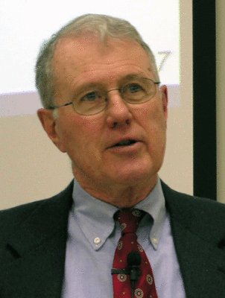
Genesis
Lecture 24: Genesis 22 – Akedah, Binding of Isaac
Dr. Robert Vannoy
ReNarrated by Ted Hildebrandt
© 2023 Robert Vannoy & Ted Hildebrandt

Slide 2
Genesis
Genesis 22: Abraham and Isaac, Son of the Promise
Genesis 22:8, 14 – God Will Provide the Lamb – Jehovah Jireh
Genesis 22:12 God says, “Now I know” – Anthropomorphic Expression
Main Focus of the Akedah [Kaiser & Vos]
Vannoy’s Reflections
Abraham’s Lapses – She’s My Sister [Gen. 12 & 20]
On Camels
Genesis 20 Abimelech, Abraham and Sarah and Its Background: God’s Promise
of Isaac’s birth
Promise to Abraham of a Son by Sarah
Sarah, Hagar and Hammurabi’s Code

Slide 3
Genesis
Video based on audio from Dr. Vannoy’s class at Biblical Theological
Seminary. It was renarrated because the original audio was scratchy
and it was turned into video by Ted Hildebrandt for Biblicalelearning.org.

