Slide 1

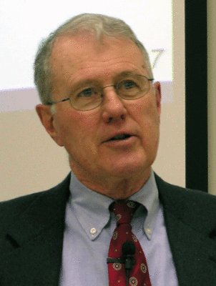
Genesis
Lecture 12: Genesis 3 – The Fall – Process of Surrender, Initial Results
Dr. Robert Vannoy
ReNarrated by Ted Hildebrandt
© 2023 Robert Vannoy & Ted Hildebrandt

Slide 2
Genesis
Genesis 3 – Fall into Sin …
c. The Process of Surrender
    1. Injection Doubt
    2. Sharpening the Prohibition
    3. Accusation accusing God
    4. Mixing Truth and Falsehood
    5. She becomes Autonomous Violating God’s Command
    6. Eve Gives the Fruit to Adam
  d. The Suddenness of the Result – on Shame

Slide 3
Genesis
Video based on audio from Dr. Vannoy’s class at Biblical Theological
Seminary. It was renarrated because the original audio was scratchy
and it was turned into video by Ted Hildebrandt for Biblicalelearning.org.

