Slide 1

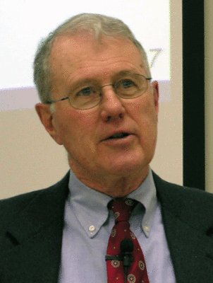
Genesis
Lecture 2: Form Criticism – Gerhard Von Rad
Dr. Robert Vannoy
ReNarrated by Ted Hildebrandt
© 2023 Robert Vannoy & Ted Hildebrandt

Slide 2
Genesis
Review
1. “Statements of Belief” Stand Behind the Hexateuch as a Whole
2. The Hexateuch is an Aggregation of Diverse Materials, which Have Been
Changed to the Present Form under the Guidance of the Credo
3. The Hexateuch as a Whole Must Be Understood as a Gattung/Sitz im Leben
a. Elaborate the Third Point
b. Those Statements of Belief in Passages Such as the Credo in Deut. 26:5-9
c. Relation to JEDP and the Hexateuch’s Final Form
d. Historie & Heilgeschichte
e. Saving History that Was Drawn Up by Faith and Is Accordingly Confessional
in Character
f. How Heilsgeschichte was Built Up

Slide 3
Genesis
  g. Vannoy’s Response
  h. Exodus 14 Example
  i. Heilsgeschichte and Biblical Faith
2. Concessionary Evangelicalism
  Vannoy’s Analysis of Kuitert’s Work
    a. Examples of Problems and Solutions in OT History
      1. Burial of Uzziah
      2. Cities Traded Between Solomon and Hiram
      3. Who Killed Goliath?
      4. Kuitert’s Improper Conclusions

Slide 4
Genesis
Video based on audio from Dr. Vannoy’s class at Biblical Theological
Seminary. It was renarrated because the original audio was scratchy
and it was turned into video by Ted Hildebrandt for Biblicalelearning.org.

