Slide 1
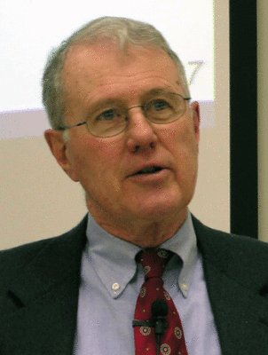

Foundations of Biblical Prophecy
Lecture 1B Prophetism in Ancient
Israel – Some General Remarks
Dr. Robert Vannoy
ReNarrated by Ted Hildebrandt
© 2023 Robert Vannoy & Ted Hildebrandt

Slide 2
Foundations of Biblical Prophecy
1. Prophetism In Ancient Israel – Some General Remarks
A. Prophetism in Israel is a Unique Phenomenon
  1. Various Country’s Unique Aptitudes
  2. Israel’s Genius at Producing Prophets
  3. Divine Revelation
  4. Prophets endowed by God

Slide 3
Foundations of Biblical Prophecy
B. Prophets were Servants of God invested with the Prophetic Function -- Prophets were Servants of God
  1. Some of the Prophets Received a Special Call to the Prophetic Task
    a. Isaiah’s Call (Isa. 6)
    b. Jeremiah’s Call (Jer. 1)
    c. Ezekiel’s Call (Ezek. 1-3)
    d. Amos’ Call (Amos 7)

Slide 4
Foundations of Biblical Prophecy
2. For some prophets, no special calling is recorded
  a. Balaam – no official call narrative
  b. David – performed other functions as well
  c. Prophets were aware that they had been endowed by God
  with the prophetic function
3. The Endowment of Prophetic Function was a Power no Prophet
Could Resist
  a. Amos
  b. Jeremiah

Slide 5
Foundations of Biblical Prophecy
C. The Function of the Prophet is the Proclamation of the Word
of God
Deuteronomy 18
Jeremiah 1:9
Jeremiah 23:16
1. Expressions with which the Prophets Introduced Their Sermons
are Indicative that the Message is God’s, not Their Own
2. The Prophets Must Declare God’s Word Regardless of Whether or
Not It was Pleasant to Him
  a. Samuel Anointing Saul
  b. Balaam

Slide 6
Foundations of Biblical Prophecy
3. There is a distinction between the Prophet’s Own Word and the
Word of God and He Spoke; and the prophets were aware of
that distinction – discuss next time
Video based on audio from Dr. Vannoy’s class at Biblical Theological Seminary. It was renarrated because the original audio was scratchy and turned into video by Ted Hildebrandt for Biblicalelearning.org.

