Slide 1

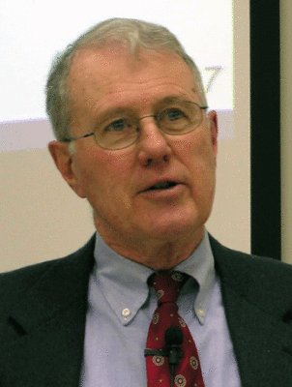
Foundations of Biblical Prophecy
Lecture 19: Joel 2-3
Dr. Robert Vannoy
ReNarrated by Ted Hildebrandt
© 2023 Robert Vannoy & Ted Hildebrandt

Slide 2
Foundations of Biblical Prophecy
1. Joel 2:17-18
2. Joel 2:23b Rain or Teacher of Righteousness
  Dittography – Moreh (teacher) written instead of Yoreh (rain)
  Messianic Prophecy cf. Qumran
  Payne Sees it as a Self-Reference to Joel Himself
  Vannoy’s Analysis: Covenant way, Teacher, Rain Connections
3. Joel 2:28-32 and its Connection to Acts 2:14ff—Different Approaches
  Joel 2:28
  “Afterwards” and/or “in the last day”

Slide 3
Foundations of Biblical Prophecy
  Pouring out of the Spirit
  Holy Spirit in the Old Testament
  Difference of the Work of the Spirit in the OT and NT [Leon Wood]
  Baptism of the Spirit in 1 Cor 12:13-14
  Return to Joel 2:28a and the Work of the Spirit in Acts
4. Joel 2:30-32 Signs and the Spirit at Pentecost
  Bavinck (Reformed Dogmatics) on the Spirit
  Joel 2:31 and the Work of the Spirit in Acts

Slide 4
Foundations of Biblical Prophecy
5. Comments on Joel 3 Judging of the Nations and Salvation of God’s
People
  Joel 3:1 in those days
  Valley of Jehoshaphat
  Joel 3:2 Judgment on the Nations
Video based on audio from Dr. Vannoy’s class at Biblical Theological Seminary. It was renarrated because the original audio was scratchy
and it was turned into video by Ted Hildebrandt for Biblicalelearning.org.

