Slide 1

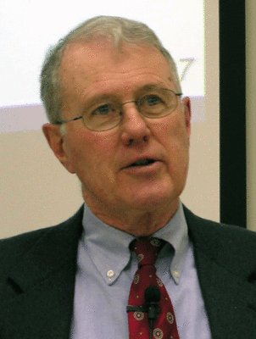
Foundations of Biblical Prophecy
Lecture 11 Literary Critics on Isaiah
and Daniel
Dr. Robert Vannoy
ReNarrated by Ted Hildebrandt
© 2023 Robert Vannoy & Ted Hildebrandt

Slide 2
Foundations of Biblical Prophecy
  Were the Prophets Writers?
  B. The Literary Critical School Continued
  1. Isaiah 40-66 – continued
  a) The Concepts and Ideas in Isaiah 40-66 are different from
  those of Isa. 1-39
  b) There are differences in language and in style in the two
  parts of the book – ani/anoki and amar examples
          1. Rachel Margalioth refuting the argument from style and language
          2. Margalioth’s arguments for the Unity of Isaiah – NT quotes

Slide 3
Foundations of Biblical Prophecy
      3) Redactional Unity
      4) Mark Rooker
      5) Computer Analysis of Linguistic Data
  3. The Argument from Historical Background
    a. Explanations
      1) Second Isaiah Historically Divergent
    b. Problems with this View – Need for words of Comfort
    c. Summary Conclusion
    d) Some Final Arguments for the Unity of Isaiah
    e) Longman and Dillard’s Intro to OT and the Unity of Isaiah

Slide 4
Foundations of Biblical Prophecy
  f) Final Arguments Continued
    1) God and the Prediction of the Future
    2) Comparison to Deut. 34 and Isa. 40-66
    3) Contra Deut. 34 Comparison
    4) Longman/Dillard argument - Isaiah not mentioned in Isa. 40-66
    5) Richard Schultz’s Response
    6) Vannoy’s Response to Longman/Dillard

Slide 5
Foundations of Biblical Prophecy
  2. Daniel: There’s a General Consensus Among Mainstream
  Critical Scholar’s that the Book of Daniel is Fictional
  a. Predictive Prophecy Does Not Happen They Maintain
    1) Daniel 2 & 7 and Critical Theories
    2) Response to Critical Theories
      a) Nabonidas and Belshazzar
      b) Darius the Mede – who was he?
      c) Nebuchadnezzar as the Father instead of Grandfather of Belshazzar

Slide 6
Foundations of Biblical Prophecy
    Video based on audio from Dr. Vannoy’s class at Biblical Theological Seminary. It was renarrated because the original audio was scratchy
    and it was turned into video by Ted Hildebrandt for Biblicalelearning.org.

