Slide 1

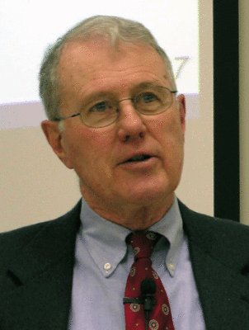
Deuteronomy
Lecture 3: Redaction, Canonical and Rhetorical Criticism
Dr. Robert Vannoy
ReNarrated by Dr. Perry Phillips
© 2023 Robert Vannoy & Ted Hildebrandt

Slide 2
Deuteronomy
Beyond Form Criticism
1. Redaction Criticism
  a. Barton’s Warning of the Danger of Redaction Criticism
  b. Evangelicals and Redaction Criticism
  c. Historical Trustworthiness Still Undermined
  d. Gundry on Matthew and Redaction Criticism
  e. Rogers and McKim and Inerrancy
2. Canonical Criticism and B. Childs [Yale]

Slide 3
Deuteronomy
3. Rhetorical Criticism: Robert Alter et al.
  a. Omniscient Narrator
  b. Other Rhetorical Critics
  c. Evangelicals and Rhetorical Criticism
  d. Non-Evangelicals Supporting the Unity of the Text Contra Source Critics
No Consensus
C.S. Lewis, History Writing and Difficulty of Literary Reviews
Video based on audio from Dr. Vannoy’s class at Biblical Theological
Seminary. It was renarrated because the original audio was scratchy
and it was turned into video by Ted Hildebrandt for Biblicalelearning.org.

