Slide 1
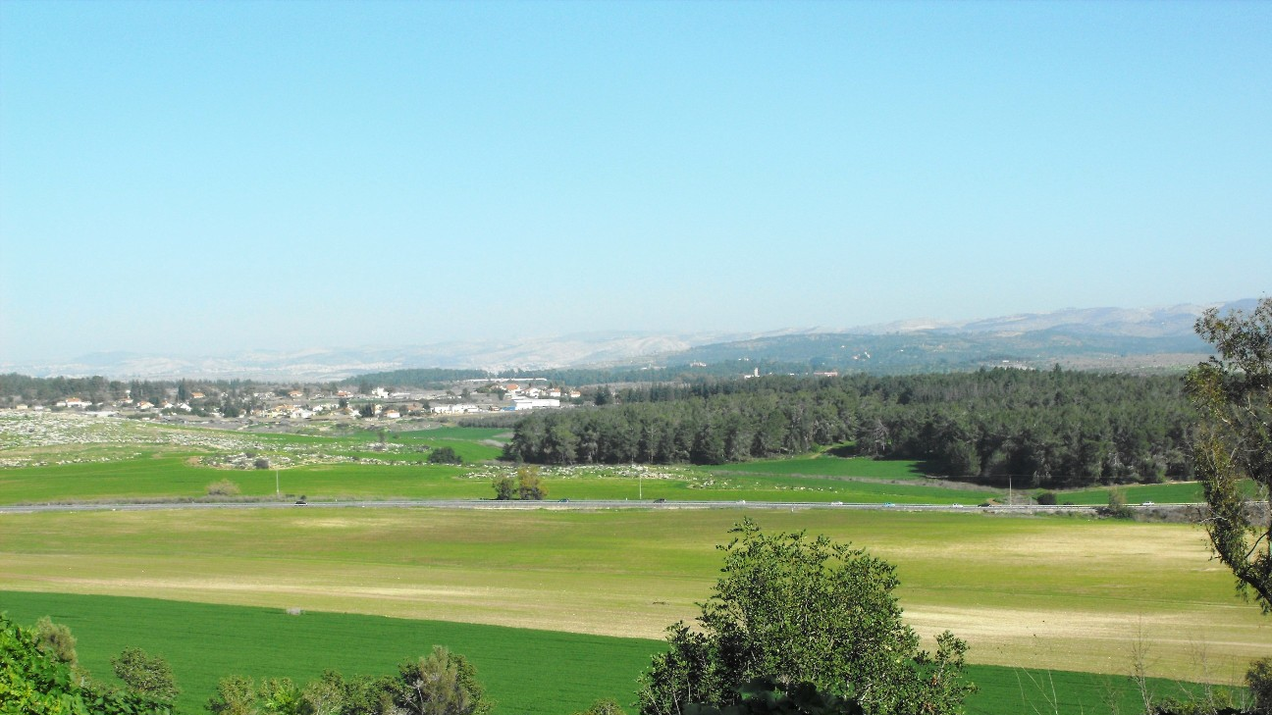
A Footnote to Biblical History: Archaeology and the Reign of Uzziah
Jeffrey P. Hudon, Ph.D.
Biblicalelearning.org
Similar to his theological treatment of Judah’s other monarchs, Chr’s account of Uzziah includes important additional information omitted in the parallel biblical treatment of this powerful eighth century BC king (2 Kgs 14:21-15:6). This paper will closely examine Chr’s supplemental data and argue, based upon biblical, historical and archaeological evidence, that Chr utilized early and annalistic sources in his account. The various historical details Chr includes provide significant insights on this largely overlooked, but long reigning Davidic ruler.

Slide 2
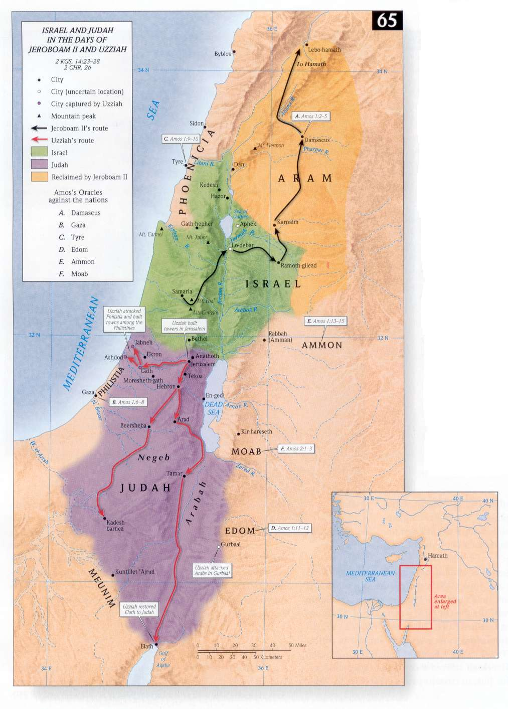
The Reign of Uzziah (Azariah) in summary
Uzziah reigned 52 years (792/91—740/39 BC) including a coregency with his father Amaziah from 792/91—767 BC.
Uzziah’s reign roughly paralleled that of Jeroboam II, the powerful king of Israel (793/92-753 BC)
Uzziah’s reign is recorded in 2 Kings 14:21-15:7 and 2 Chronicles 26:1-23 and took place during the lifetimes of the prophets Hosea, Amos, Jonah and Isaiah
Amos (1:1) and Zechariah (14:5) record an earthquake during Uzziah’s reign, which is alluded to also in Isaiah (2:19-21)

Slide 3
2 Chronicles 26—The Reign of Uzziah
Uzziah Reigns in Judah
26 And all the people of Judah took Uzziah, who was sixteen years old, and made him king instead of his father Amaziah. ² He built Eloth and restored it to Judah, after the king slept with his fathers. ³ Uzziah was sixteen years old when he began to reign, and he reigned fifty-two years in Jerusalem. His mother's name was Jecoliah of Jerusalem. ⁴ And he did what was right in the eyes of the Lord, according to all that his father Amaziah had done. ⁵ He set himself to seek God in the days of Zechariah, who instructed him in the fear of God, and as long as he sought the Lord, God made him prosper.
⁶ He went out and made war against the Philistines and broke through the wall of Gath and the wall of Jabneh and the wall of Ashdod, and he built cities in the territory of Ashdod and elsewhere among the Philistines. ⁷ God helped him against the Philistines and against the Arabians who lived in Gurbaal and against the Meunites. ⁸ The Ammonites paid tribute to Uzziah, and his fame spread even to the border of Egypt, for he became very strong. ⁹ Moreover, Uzziah built towers in Jerusalem at the Corner Gate and at the Valley Gate and at the Angle, and fortified them. ¹⁰ And he built towers in the wilderness and cut out many cisterns, for he had large herds, both in the Shephelah and in the plain, and he had farmers and vinedressers in the hills and in the fertile lands, for he loved the soil. ¹¹ Moreover, Uzziah had an army of soldiers, fit for war, in divisions according to the numbers in the muster made by Jeiel the secretary and Maaseiah the officer, under the direction of Hananiah, one of the king's commanders. ¹² The whole number of the heads of fathers' houses of mighty men of valor was 2,600. ¹³ Under their command was an army of 307,500, who could make war with mighty power, to help the king against the enemy. ¹⁴ And Uzziah prepared for all the army shields, spears, helmets, coats of mail, bows, and stones for slinging. ¹⁵ In Jerusalem he made machines, invented by skillful men, to be on the towers and the corners, to shoot arrows and great stones. And his fame spread far, for he was marvelously helped, till he was strong.
21 And King Uzziah was a leper to the day of his death, And Jotham his son was over the king's household, governing the people of the land. and being a leper lived in a separate house, for he was excluded from the house of the Lord. ²² Now the rest of the acts of Uzziah, from first to last, Isaiah the prophet the son of Amoz wrote. ²³ And Uzziah slept with his fathers, and they buried him with his fathers in the burial field that belonged to the kings, for they said, “He is a leper.” And Jotham his son reigned in his place.

Slide 4
The Book of Chronicles as a Historical Document
The Chronicler (Chr): A “forgotten” Israelite Historian and last book of the Hebrew Bible (OT)
Chr wrote a parallel history to Samuel and Kings, but from a distinctly different perspective:
A different Theological Perspective that emphasized Immediate Retribution
A different Historical Perspective from the Post-exilic or Restoration era
Addressing a different Audience with different Questions
Chr provided additional historical material and data not included in Samuel-Kings along with source citations
The Historical Question: Did Chr have access to archival material from the period of the Kingdom of Judah? Is his additional information historically credible or is it theological midrash?

Slide 5
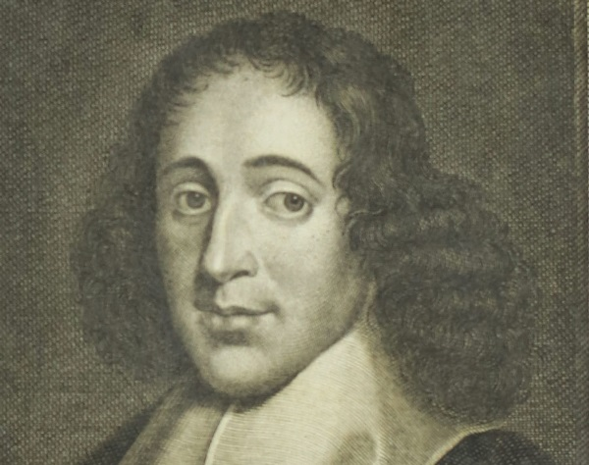
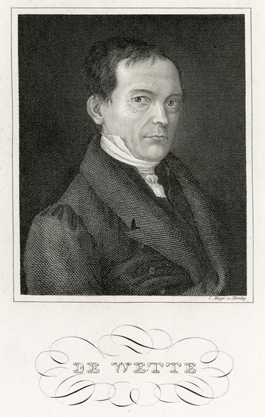
A Critical History of 2 Chronicles 26
Much like his annalistic-theological reports of several other kings of Judah, such as Rehoboam (2 Chronicles 11:5-12; his list of fortified cities), Hezekiah (32:1-5; 27-30; (defensive and other royal projects), Manasseh (33:11-14; his captivity to Babylon and later building projects), Chr’s account of Uzziah (2 Chronicles 26:6-15) provides a corpus of rich archival narrative replete with material missing from the parallel account in 2 Kings 15 regarding Uzziah.
However, skepticism rose over the reliability of Chr’s account during the seventeenth century from scholars such as Baruch de Spinoza (1632-1677) and later expanded, becoming firmly entrenched in scholarship through the 1806 work of Wilhelm Martin Leberecht de Wette (1780-1849) and developed further by Julius Wellhausen (1883).

Slide 6
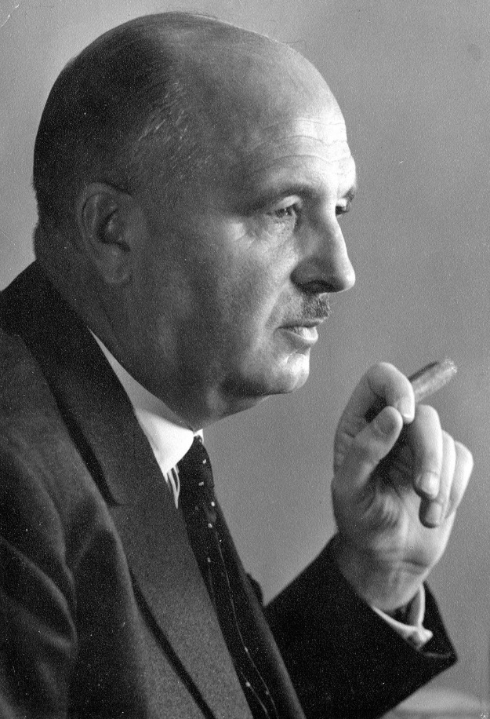
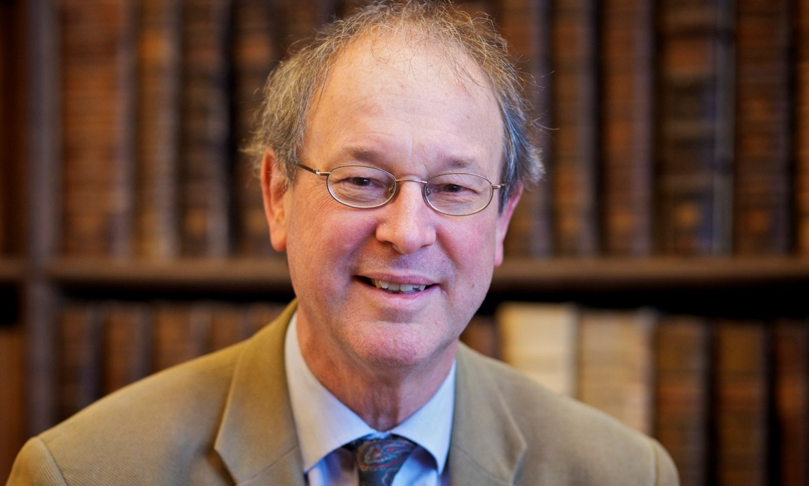
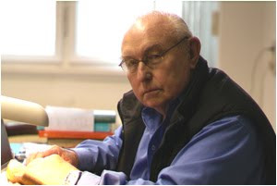
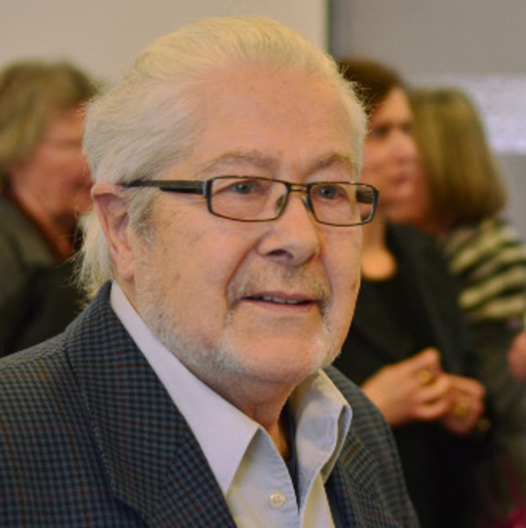
Influential Studies on Chronicles as a Historically Reliable Document
Both Martin Noth (1941) and Peter Welten (1973) were highly critical of the veracity of Chr’s material. However, both allowed that Chr probably used at least some archival material and Welten also recognized an earlier source behind 2 Chr 26:6.
Both Hugh G. M. Williamson (1982) and Anson F. Rainey (1997) argue, based on textual and archaeological evidence, that Chr utilized archival sources from the period of the monarchy.

Slide 7
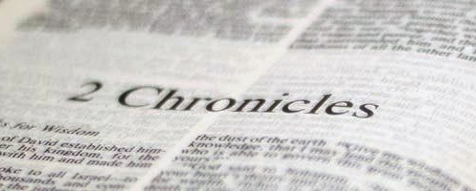
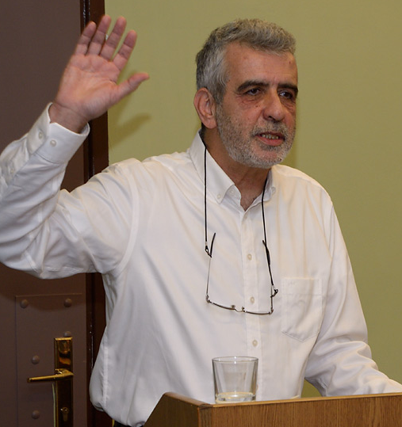
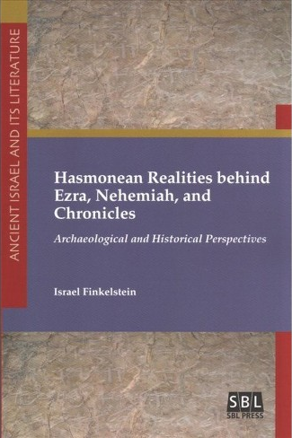
Israel Finkelstein’s Challenge
In a series of articles now collected in a book, Israeli archaeologist Israel Finkelstein (2018) attempts to date Chr’s work to the Hasmonean Period (late second to early first century BC) and thus, for all intents and purposes, declares it historically worthless for depicting Judah’s geo-political history in the Iron Age II period.
In this endeavor, Finkelstein follows in the footsteps of many Old Testament scholars from Spinoza to de Wette and onward to the present.
Thus, Chr’s account of Uzziah’s reign provides an excellent “test case” for assessing the veracity of historical details preserved solely by Chr.

Slide 8
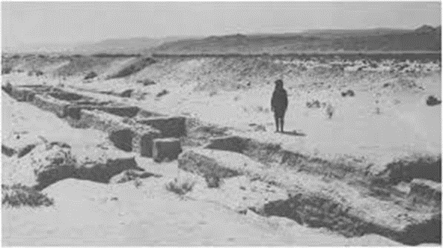
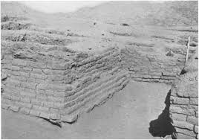
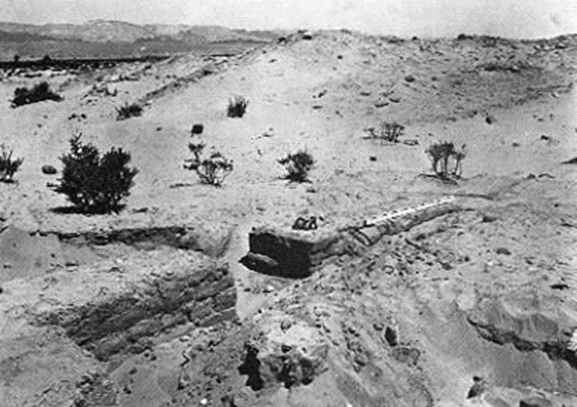
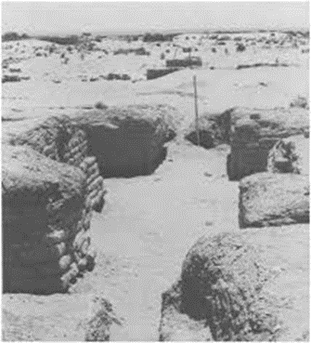
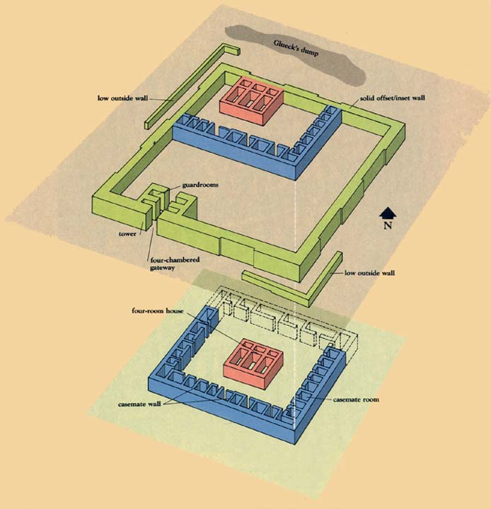
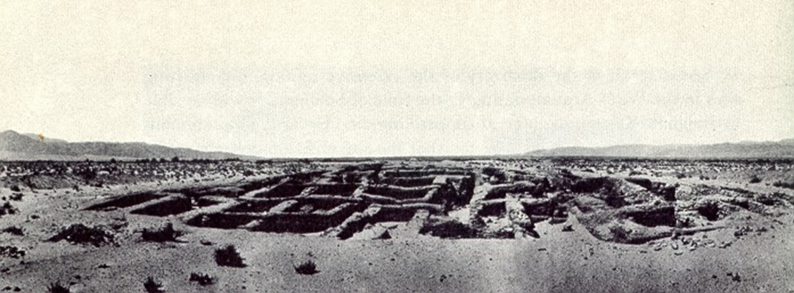
Elath and the Arabah
Uzziah’s hegemony over Elath is mentioned in both 2 Chr 26:2; and 2 Kgs 14:21-22
Elath is tentatively identified with Tell el-Kheleifeh, a fortified site with eighth century BC occupation evidence that lies between modern Elat (Israel) and Aqaba (Jordan).
Hegemony over Elath enabled Uzziah access to Red Sea trade and was a major accomplishment of his reign.
Rainey (1997:62-63) suggests that all of Chr’s additional data about Uzziah’s reign “provides the necessary background for understanding how Uzziah could eventually establish a new fortified presence at Elath.”

Slide 9
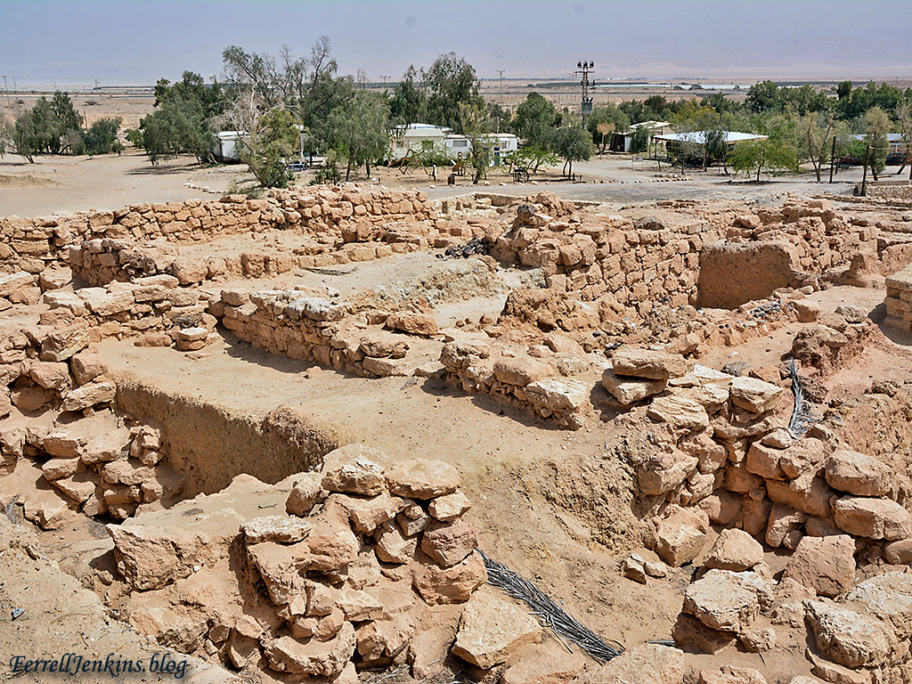
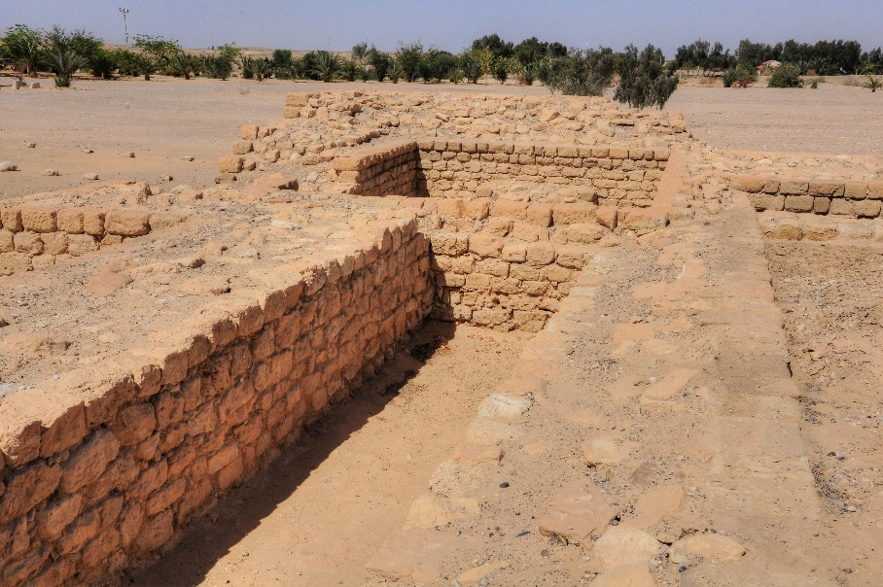
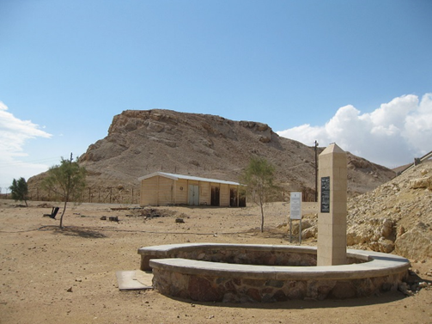
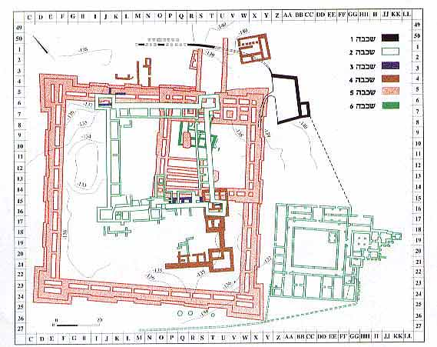
Tamar and Yotvata
‘En Hazeva, a site identified with biblical Tamar (1 Kgs 9:17-18; 2 Chr 8:4; Ezekiel 47:19; 48:28), is a large 10,000 square meter rectangular fort at a major crossroads south of the Dead Sea in the Arabah. Stratum 5 is dated to the ninth-eighth centuries BC and probably served as Judah’s base of operations to the south and east, as well as controlling trade.
Yotvata, an oasis farther south in the Arabah, has earlier Iron Age remains on a high butte, but ceramic evidence seems to predate the eighth century BC.

Slide 10
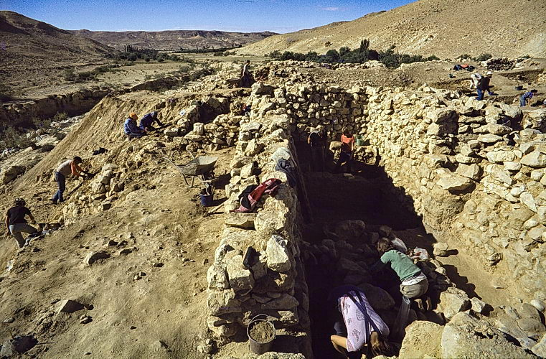
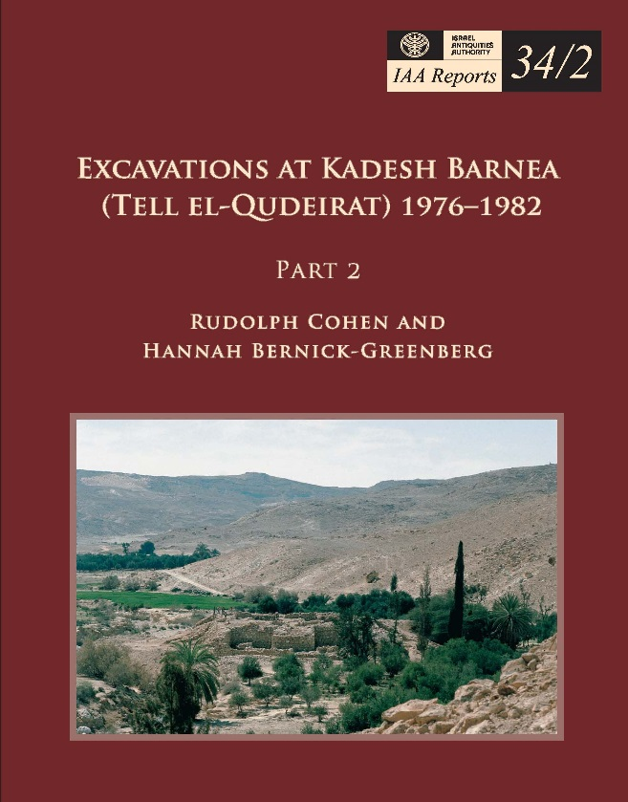
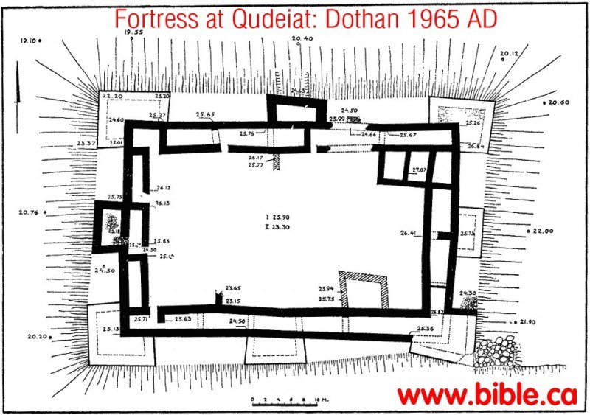
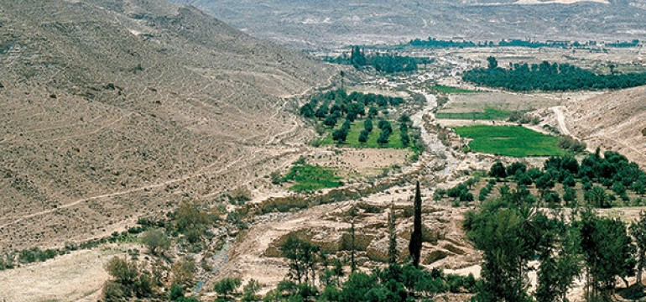
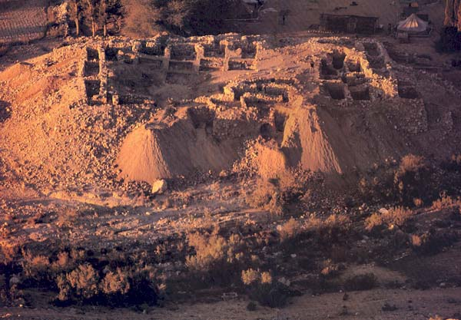
Uzziah at Kadesh Barnea
A massive square fortress with eight towers was unearthed at ‘Ain el Qudeirat in eastern Sinai and identified with biblical Kadesh Barnea.
The fort shows extensive eighth century BC occupational evidence and served Judah as a border post and also oversaw the spice route.

Slide 11

Uzziah’s Expansion into Philistia
וַיֵּצֵא, וַיִּלָּחֶם בַּפְּלִשְׁתִּים, וַיִּפְרֹץ אֶת-חוֹמַת גַּת וְאֵת חוֹמַת יַבְנֵה, וְאֵת חוֹמַת אַשְׁדּוֹד; וַיִּבְנֶה עָרִים, בְּאַשְׁדּוֹד וּבַפְּלִשְׁתִּים
He went out and made war against the Philistines and broke through the wall of Gath and the wall of Jabneh and the wall of Ashdod, and he built cities in the territory of Ashdod and elsewhere among the Philistines (2 Chr 26:6 ESV).
Extensive evidence at numerous sites in the western Shephelah, notably Beer Sheba, Lachish and Tell el Hesi, as well as many others along the coastal plain show a strong and resurgent Judah.
Uzziah’s aim undoubtedly was to reassert a Judahite presence along the coastal route and provide direct access to Mediterranean trade
Chr’s description also provides a rare example of a recorded campaign route taken by Judah’s army (Aharoni 1979).

Slide 12
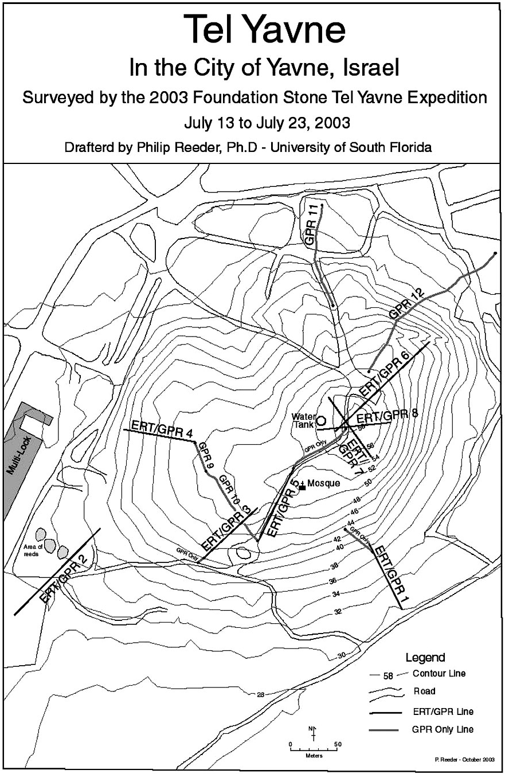
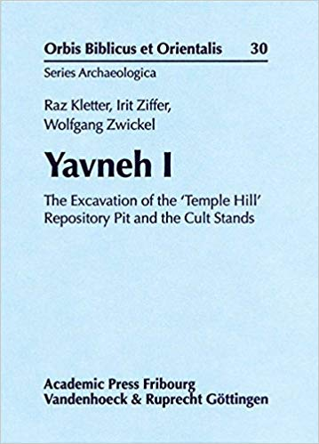
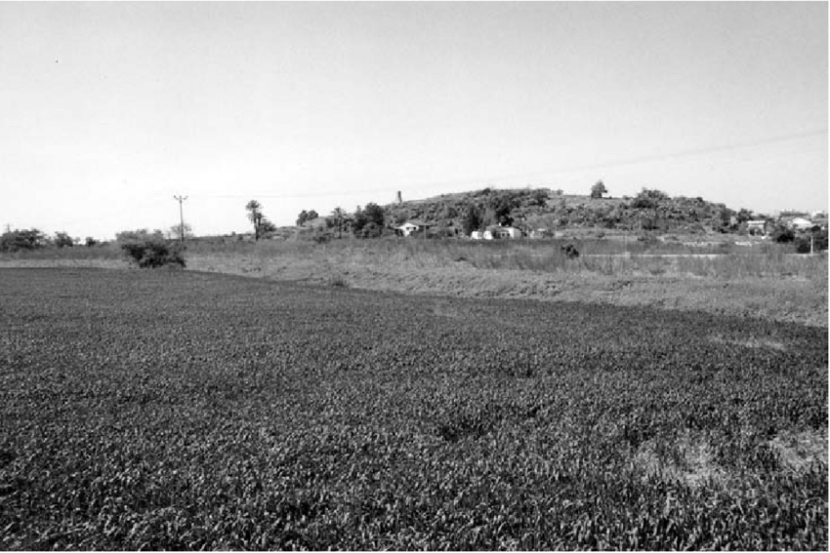
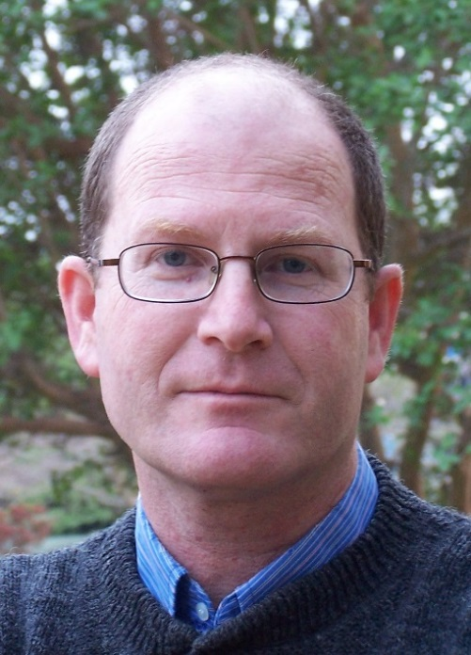
Evidence of Uzziah at Yavneh?
Tel Yavneh is located SE of Tel Aviv and has yet to be extensively excavated due in part to extensive medieval remains that cover her summit.
Chance discoveries of cultic figurines and vessels led to dramatic finds on a small adjacent mound, called “Temple Hill.” Excavations by Raz Kletter revealed a huge favissa or repository pit with ceremonially smashed vessels.
This rich assemblage dates to the late ninth-early eighth centuries BC and demonstrates Philistine influences, showing the site existed as a Philistine city just prior to and during Uzziah’s reign

Slide 13
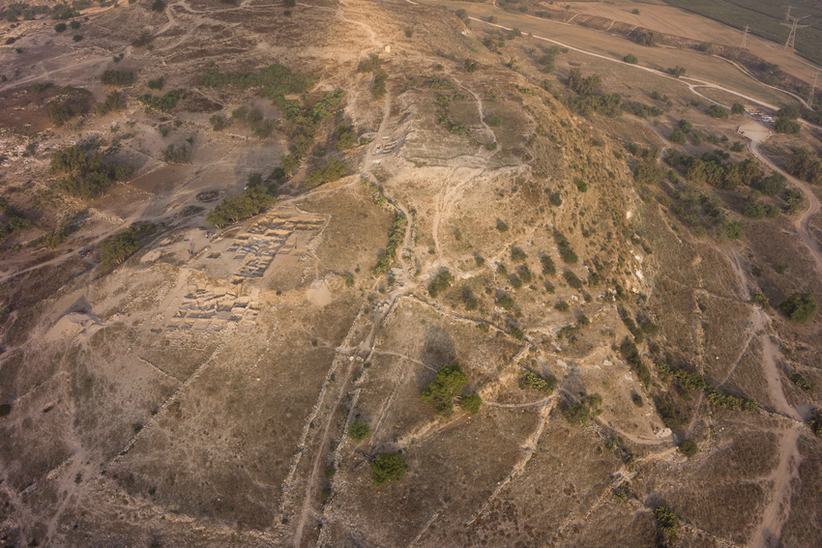
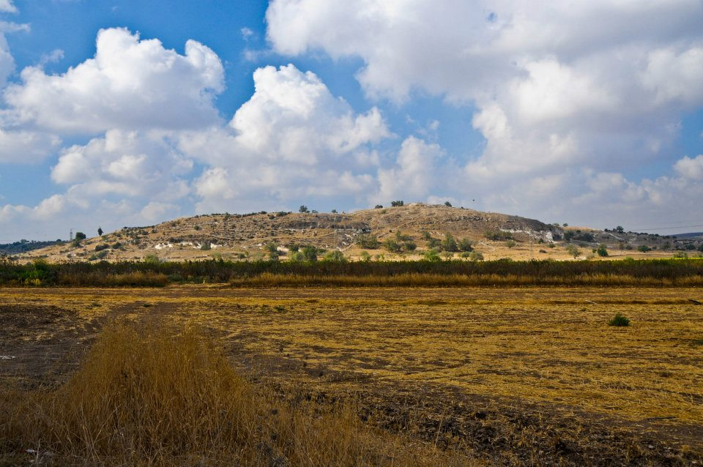
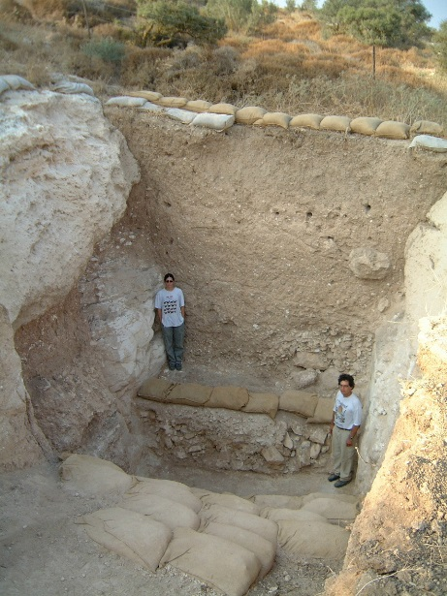
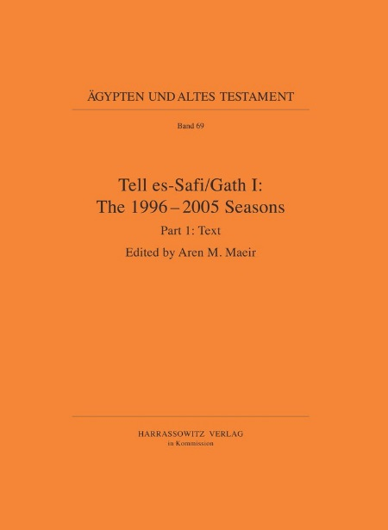
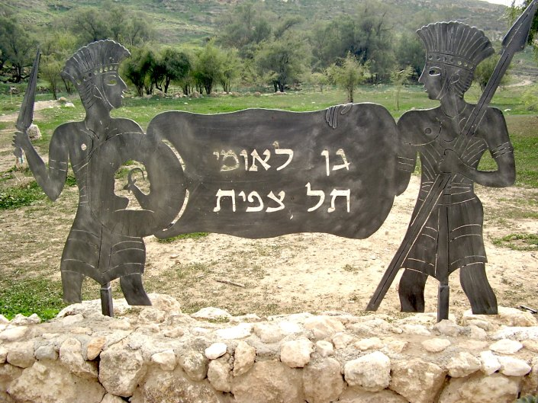
Uzziah at Gath: Tell es-Safi or Tell Ras Abu Hamid?
The prominent site of Tell es-Safi, identified with Gath of the Philistines, was destroyed during the late ninth century BC by Hazael of Aram Damascus (2 Kgs 12:17).
A large 60 acre Judahite settlement rose at the site beginning in ca. 750 BC (towards the end of Uzziah’s reign and denoted as stratum A2), but no sign yet exists of an earlier eighth century BC destruction layer
Another site, Gath-Gittaim, identified with Tell Ras Abu Hamid to the NW of Tell es-Safi, may also be a candidate for Uzziah’s Gath and exhibits early eighth century BC occupational evidence (Stratum VI).

Slide 14
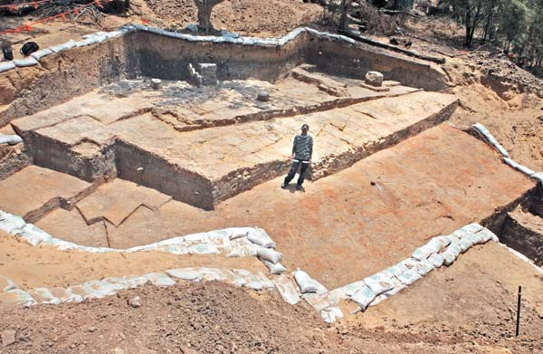
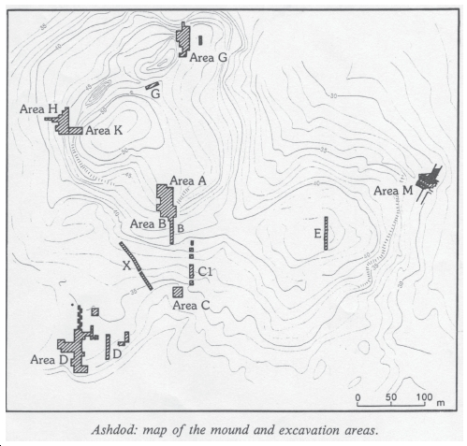
Uzziah at Ashdod and the Surrounding Settlements
Ashdod was a major Philistine city covering 90 acres. Strata 9-7 date to the eighth century BC.
A large six chamber gate from Area M closely parallels similar gates in Israel and Judah, notably an eighth century BC gate at Tel ‘Ira. While the excavator attributed the destruction of this gate to Uzziah, recent studies dispute this. Rather, Uzziah may have actually erected this gate after occupying the city. A lmlk stamped handle and Hebrew inscriptions may also hint a Judahite control.
Salvage excavations at the base of the tel revealed an Assyrian administrative structure and two eighth century BC destructive layers beneath it.
Coastal sites that show possible eighth century BC occupational evidence include Yavneh-Yam, Rishon le-Zion, Mesad Hashavyahu, Holot Yavne, Tel Mor and additional sites in the vicinity of Ashkelon and Gaza. These may have served Uzziah as new Judahite settlements

Slide 15
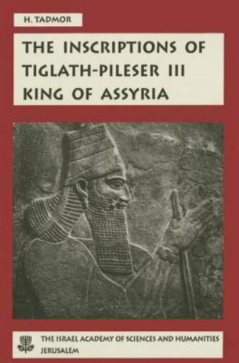
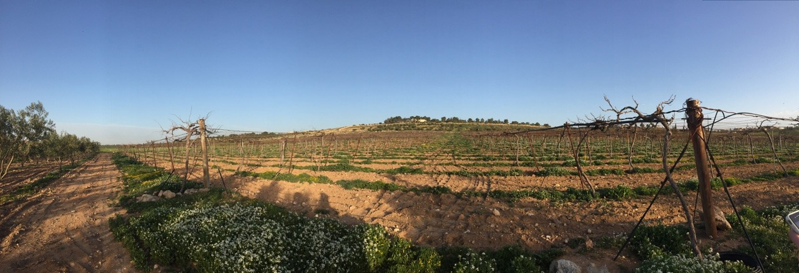
Uzziah’s Domination of the Ammonites, Arabs and Meunites
וַיַּעְזְרֵהוּ הָאֱלֹהִים עַל-פְּלִשְׁתִּים וְעַל-הערביים (הָעַרְבִים), הַיֹּשְׁבִים בְּגוּר-בָּעַל--וְהַמְּעוּנִים.
God helped him against the Philistines and against the Arabians who lived in Gurbaal and against the Meunites. The Ammonites paid tribute to Uzziah (2 Chr 26:7-8a)
The Meunites were unknown outside of the biblical texts until Hayim Tadmor read their name in the annals of Assyrian king Tiglath-pileser III (745-727 BC).
Evidence from Tall Jalul, near Madaba, Jordan, seems to indicate Judahite influence in the Ammonite mishor (2 Chr 26:10) during the eight century BC

Slide 16
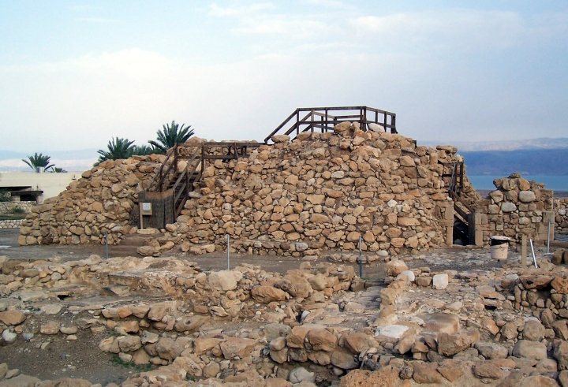
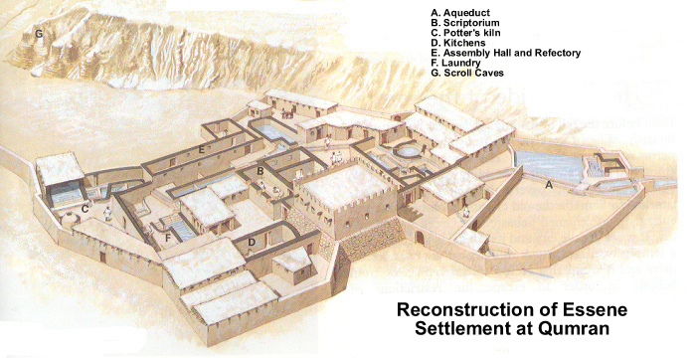
Uzziah’s Towers and Cisterns in the Steppe (Wilderness of Judah)
וַיִּבֶן מִגְדָּלִים בַּמִּדְבָּר, וַיַּחְצֹב בֹּרוֹת רַבִּים
And he built towers in the wilderness and cut out many cisterns (2 Chr 26:9 ESV)
Iron Age II (eighth century BC) fortified settlements, towers, cisterns and water catchment systems at Qumran, Ein Feshkha, Ein Gedi, three sites in the Valley of Achor and Mesad Gozal
Despite the clear reference to the Wilderness of Judah here, many scholars also identified remains in the Negeb Highlands to Uzziah

Slide 17
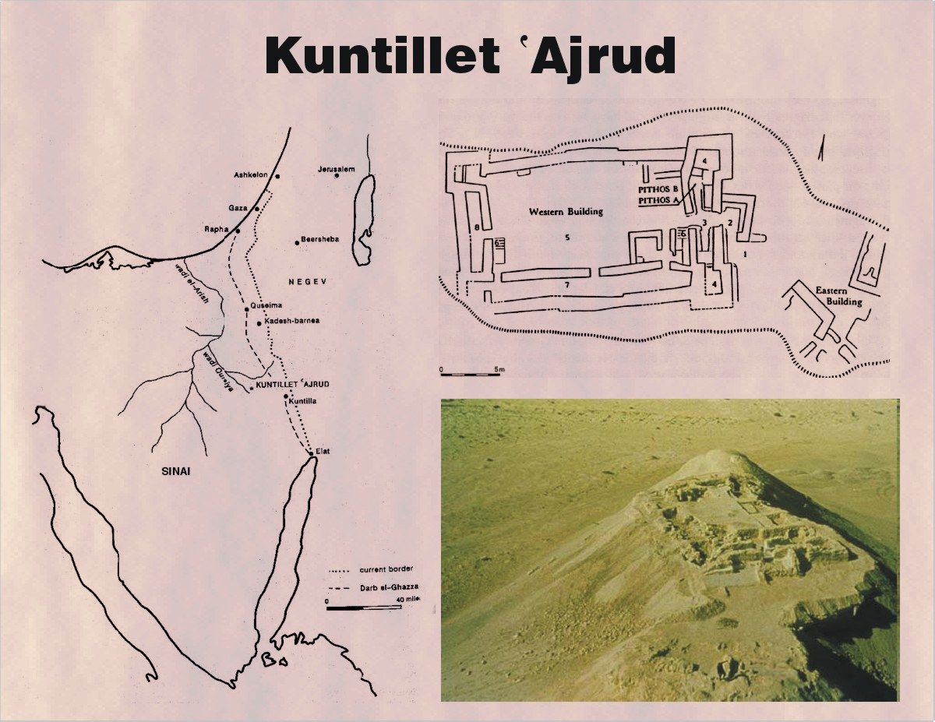
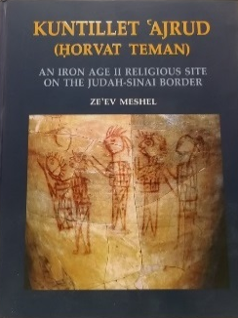
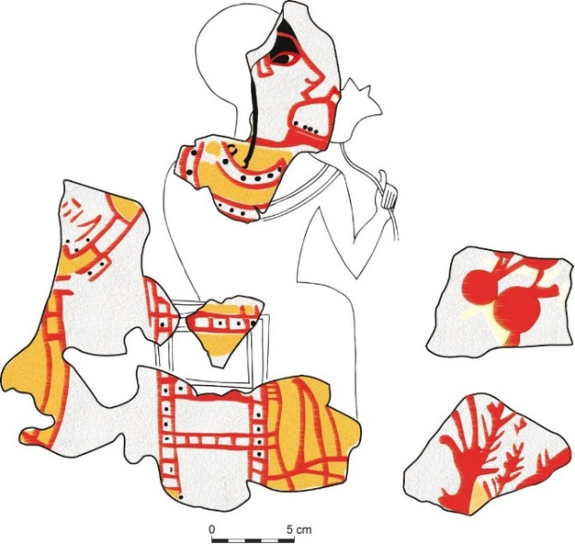
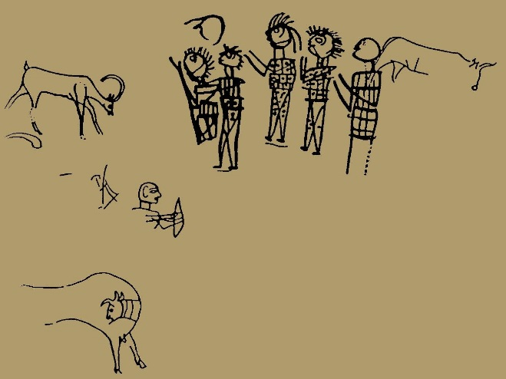
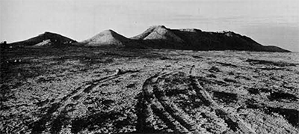
Uzziah’s Name was known “to the Borders of Egypt”
וַיֵּלֶךְ שְׁמוֹ עַד-לְבוֹא מִצְרַיִם
…and his (Uzziah’s) fame spread even to the border of Egypt, for he became very strong (2 Chr 26:8 ESV)
The ninth-eighth century BC site of Kuntillet ‘Ajrud in east Sinai bears evidence (both ceramic and epigraphic) of a joint Israelite-Judahite venture to establish a border and trading post near the Gaza Road. This foreign trade connectivity with Arabian caravans and geo-political contact with Egyptians is reflected in Chr’s statement above

Slide 18
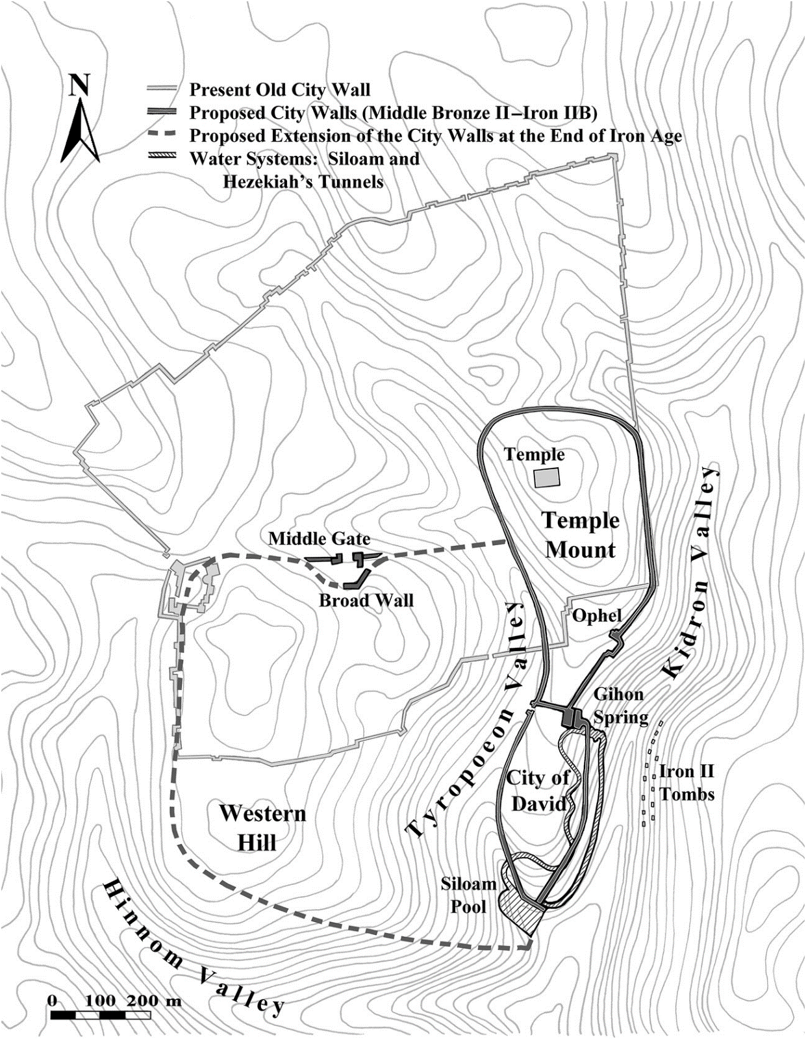
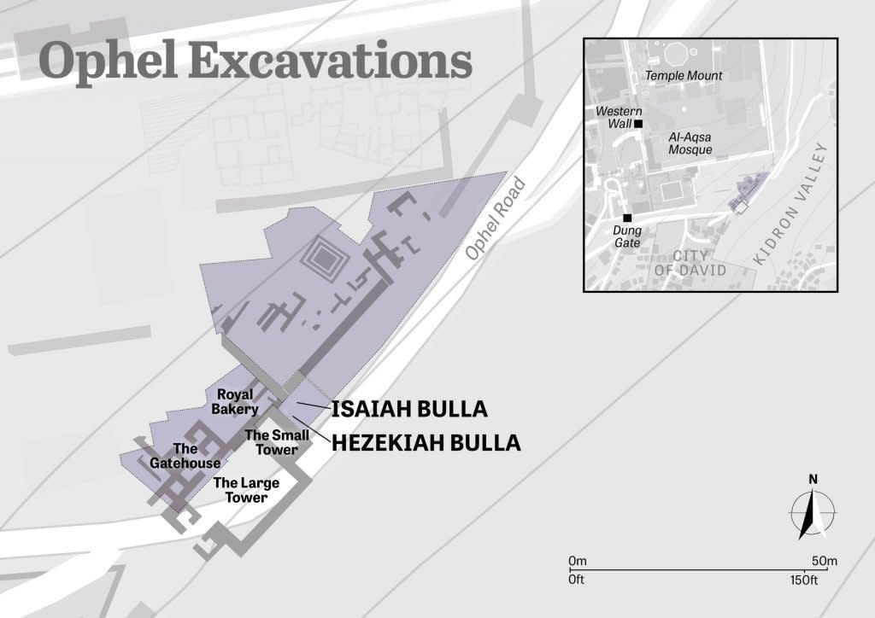
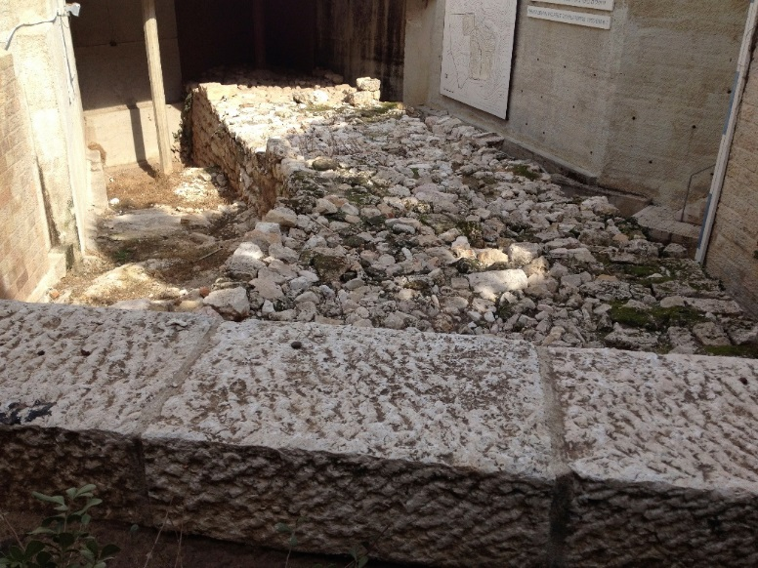
Jerusalem and Environs
וַיִּבֶן עֻזִּיָּהוּ מִגְדָּלִים בִּירוּשָׁלִַם, עַל-שַׁעַר הַפִּנָּה וְעַל-שַׁעַר הַגַּיְא וְעַל-הַמִּקְצוֹעַ; וַיְחַזְּקֵם
Moreover, Uzziah built towers in Jerusalem at the Corner Gate and at the Valley Gate and at the Angle, and fortified them (2 Chr 26:9 ESV).
Excavations by Charles Warren, Kathleen Kenyon and Eilat Mazar have uncovered a tower and royal gateway along the slanted Ophel wall that may be identified as the Angle Tower and Water Gate.
The location of the Valley Gate and Corner Gate are uncertain and may either reflect an earlier walled expansion onto the Western Hill or may be part of the original defenses surrounding the City of David and Temple Mount (2 Kgs 14:13; 2 Chr 25:23; Jer 31:38; Neh 2:13-15; 3:13, 31-32).

Slide 19
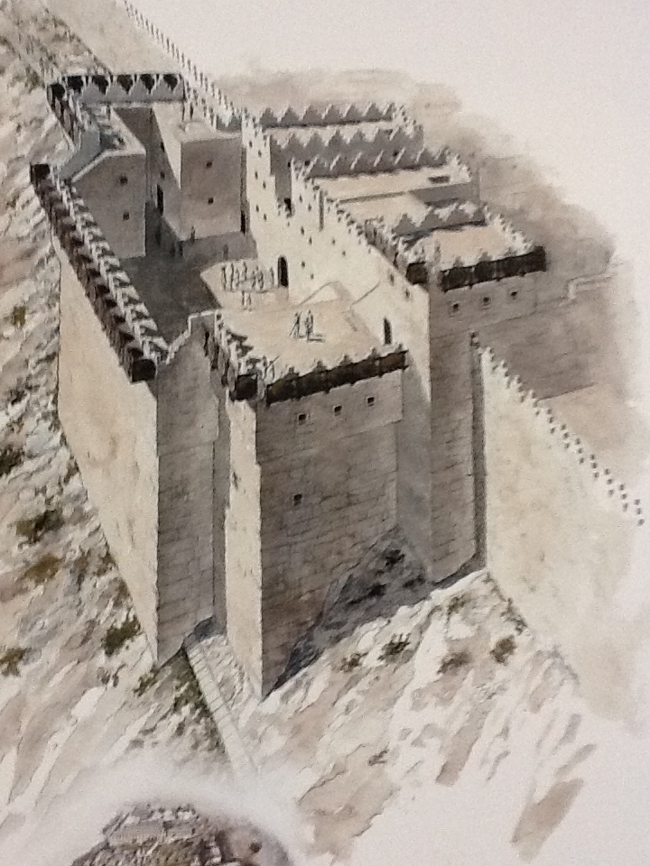




The Ophel Gateway
The Royal Quarter of Jerusalem during the Kingdom of Judah

Slide 20

Did Uzziah Inherit Jeroboam II’s Northern Conquest?
²⁸ Now the rest of the acts of Jeroboam and all that he did, and his might, how he fought, and how he restored Damascus and Hamath to Judah in Israel, are they not written in the Book of the Chronicles of the Kings of Israel? (2 Kgs 14:28 ESV)
Did Judah inherit the Israelite empire of Jeroboam II?
The mention of “Azriyahu of Yaudi” (Azariah of Judah) in the inscriptions of Tiglath-pileser III

Slide 21




Uzziah’s Quarantine and Burial at Ramat Rahel
2 Chr 26:21-23 (2 Kgs 15:5-6)
Uzziah’s confinement to a “Separate House” or the euphemistically titled “House of Freedom” due to skin disease later in his reign may have been at the eighth-seventh century BC Iron Age palace at Ramat Rahel, a hilltop kibbutz 3 km south of Jerusalem
וַיֵּשֶׁב בֵּית החפשות (הַחָפְשִׁית)
Identified with biblical Beth Hakerem, Ramat Rahel overlooks the Rephaim Valley and probably served as the palace complex for a vast royal estate during the reign of Uzziah and later kings of Judah. Monumental evidence, including an engaged volute capital and a beautifully hewn 525 foot long water tunnel at Walajeh, a site farther west along the Rephaim Valley, strongly supports this supposition.
Uzziah’s gravestone, written in Aramaic, mentions the transfer and reburial of his bones at a different location, proving the veracity of the biblical accounts of his burial (Sukenik 1931)

Slide 22
Conclusions
The preponderance of evidence from written and archaeological sources support an eighth century BC geo-political context for Chr’s account of Uzziah (2 Chr 26)
-Chr’s references to Philistines, (Ammonites), Edomites, and especially to Meunites all reflect well documented eighth century BC polities. Likewise, Chr’s mention of sites such as Gur Baal, Elath, Gath, Ashdod and Yavneh are not necessarily attested during the late Persian and Hellenistic Period
-Rapid intensification and expansion of Judahite settlement in the hill country, western Shephelah, the Wilderness of Judah, the Negeb and Elath occurs throughout the eighth century (2 Chr 26:2, 6-10; 2 Kgs 14:21-22)
-Destruction evidence and a six chamber “Solomonic” gate at Ashdod and Judahite settlement at Tell es Safi (Gath) as well as other sites in the coastal plain provide evidence for 2 Chr 26:6
-The continued expansion of Jerusalem to the north and west, encompassing the Western Hill and evidence of walls and gates that may represent those mentioned in 2 Chr 26:9
-Joint geo-political maneuvers with the Kingdom of Israel under Jeroboam II at Horvat Teman on the border of Egypt and evidence of Judahite influence at Tall Jalul in the tableland of central Jordan (2 Chr 26:8-10) support Chr’s narrative
Consequently, there is essentially no basis to the view that Chr invented this account using a late Persian or Hellenistic Period milieu or “template.” Rather, Chr clearly accessed, but selectively utilized archival sources from the period of the monarchy to write his history of Judah

Slide 23


Thank You!

Slide 25





Ramat Rahel: A Royal Palace of Judah
Located only 3 km south of Jerusalem, Ramat Rahel served as a summer palace and royal estate for Judah’s later kings and may be the “separate house” mentioned as a quarantine palace for Uzziah after he contracted skin disease. The expense and workmanship evident at this site shows it to be a worthy successor to the magnificent palace at Samaria. A tower to the east of Ramat Rahel was recently excavated and probably served as an eastern lookout point.

Slide 26





Slide 27







Elath and
Ezion-Geber

Slide 28






Yotvata

Slide 29



Slide 30
Cite verses above the slide
Looking at the glass half full, not half empty

