Slide 1

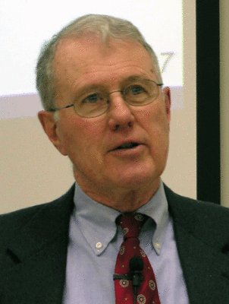
Major Prophets
Lecture 28: Gog and Magog, Meschech and Tubal in Ezek. 38 & 39
Dr. Robert Vannoy
ReNarrated by Dr. Perry Phillips
© 2023 Robert Vannoy & Ted Hildebrandt

Slide 2
Major Prophets
Reflections on Modern Israel and the Kingdom of God [already but not yet]
Context of Ezekiel 38-39 and Rev. 20 [Gog and Magog]
Ellison – Gog and Magog Prior to the Second Advent
Ezekiel 38:2 Chief Prince or Prince of Rosh
Revelation 20:8
Reflections on Gog and Magog and the Millennium
Lindsey on Rosh [head/prince] or Place name [Rosh] Contra Keil
3.D.3. Alexander on Rosh
Yamauchi’s Response to Lindsey on Tubal & Meshech
Alexander’s Double Fulfillment Prior to and After the Millennium

Slide 3
Major Prophets
Vannoy’s Response
Video based on audio from Dr. Vannoy’s class at Biblical Theological
Seminary. It was renarrated by Dr. Perry Phillips because the original audio
was scratchy and it was turned into video by Ted Hildebrandt for Biblicalelearning.org.

