Slide 1

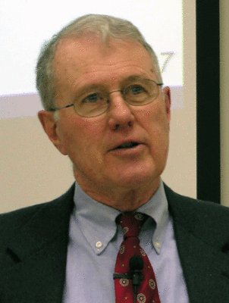
Major Prophets
Lecture 24: Daniel 2 – Vision of the 4 Kingdoms Statue & Smashing Stone
Dr. Robert Vannoy
ReNarrated by Dr. Perry Phillips
© 2023 Robert Vannoy & Ted Hildebrandt

Slide 2
Major Prophets
3. Daniel 2 & 7
a. Death of the Magicians/wisemen & Daniel Receives Revelation
b. Interpretation of Nebuchadnezzar’s Statue Dream
1. What 4 Kingdoms are Described: 3 Views
  a. Critical View: Climax is the Time of Antiochus Epiphanes (ca 165 BC) and
  the Smashing Stone is the Jewish Uprising
  b. First Advent View – Christ as the Smashing Stone
  Some Questions
  C. Second Advent View – Christ’s Second Coming is the Smashing Stone
  Problems with a Gap

Slide 3
Major Prophets
2. Objections to the Various Approaches
Need for Comparisons and Parallels with Daniel 7
Video based on audio from Dr. Vannoy’s class at Biblical Theological
Seminary. It was renarrated by Dr. Perry Phillips because the original audio
was scratchy and it was turned into video by Ted Hildebrandt for Biblicalelearning.org.

