Slide 1

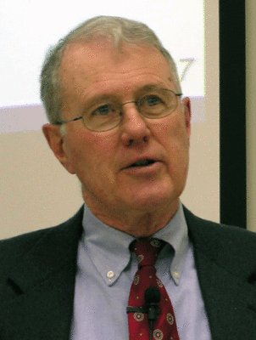
Major Prophets
Lecture 23: Daniel 8 Part II
Dr. Robert Vannoy
ReNarrated by Dr. Perry Phillips
© 2023 Robert Vannoy & Ted Hildebrandt

Slide 2
Major Prophets
Review of Daniel 8 Vision of the Ram and the He-Goat
Antiochus Epiphanes
Daniel 8:9-11 Antiochus Stomps on the Godly
Daniel 8:12 Horn Antiochus Prospers
Daniel 8:13-14 Abomination of Desolation
2300 Days (?)
Critical Fictional Approach
Who is the King of Fierce Countenance? Antiochus, Anti-Christ or both
Dual Fulfillment view: Walvoord
Typological View

Slide 3
Major Prophets
“The Time of the End”
2. Basic Approaches to the Book of Daniel
a. Critical Approach
b. Orthodox View – Amillennial – First Advent of Christ
c. End Times When God’s Kingdom Will Be Established – Second Coming
Video based on audio from Dr. Vannoy’s class at Biblical Theological
Seminary. It was renarrated by Dr. Perry Phillips because the original audio
was scratchy and it was turned into video by Ted Hildebrandt for Biblicalelearning.org.

