Slide 1

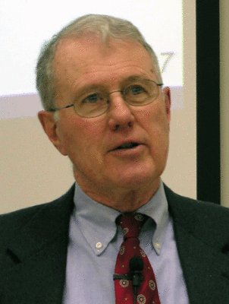
Major Prophets
Lecture 19: Isaiah 54
Dr. Robert Vannoy
ReNarrated by Dr. Perry Phillips
© 2023 Robert Vannoy & Ted Hildebrandt

Slide 2
Major Prophets
Isaiah 54:1-56:8 The Results of the Work of the Suffering Servant
Outline of Isaiah 54-56
General Comment on Isaiah 54-56
Isaiah 54:1-17 Their Righteousness is from the Lord
Outline of Isaiah 54:1-17
Isaiah 54:1-3 The Servants of the Lord are to Rejoice Because Great Increase
Is to Come to Them
Isaiah 54:4-10 The Blessing which God Has in Store for Israel in the Future
Isaiah 54:11-17 The Stability of God’s People
Isaiah 54:14-17 God Will Protect His People

Slide 3
Major Prophets
Video based on audio from Dr. Vannoy’s class at Biblical Theological
Seminary. It was renarrated by Dr. Perry Phillips because the original audio
was scratchy and it was turned into video by Ted Hildebrandt for Biblicalelearning.org.

