Slide 1

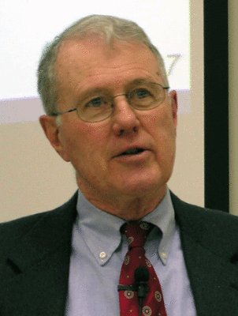
Major Prophets
Lecture 18: Servant of the Lord Theme (Isa 53) Continued
Dr. Robert Vannoy
ReNarrated by Dr. Perry Phillips
© 2023 Robert Vannoy & Ted Hildebrandt

Slide 2
Major Prophets
Isaiah 53:4 Healing Ministry of Christ
Isaiah 53:5 Why He Was Afflicted
Isaiah 53:6 Substitutionary Atonement
Isaiah 53:7 Not Israel
Isaiah 53:8 Hopelessness of His Death
Isaiah 53:9 Grave Assigned with Wicked (pl.) and a Rich man (sg)
Inorganic Prophecy
Isaiah 53:10 The Sin Offering
Isaiah 53:11 Objective Genitive: Knowledge about Him
Isaiah 53:12 He Shall Be Triumphant

Slide 3
Major Prophets
Video based on audio from Dr. Vannoy’s class at Biblical Theological
Seminary. It was renarrated by Dr. Perry Phillips because the original audio
was scratchy and it was turned into video by Ted Hildebrandt for Biblicalelearning.org.

