Slide 1

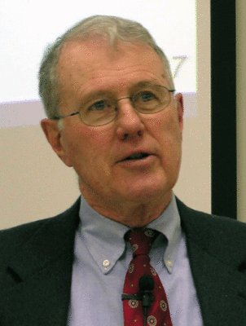
Major Prophets
Lecture 17: Servant of the Lord Theme Continued
Dr. Robert Vannoy
ReNarrated by Dr. Perry Phillips
© 2023 Robert Vannoy & Ted Hildebrandt

Slide 2
Major Prophets
Isaiah 50:4-11
Isaiah 50:5-6 Character of the Servant
Isaiah 50:8-9 One Being Helped by the Servant is Speaking
Isaiah 50:10-11 2 Groups of People
4. Isaiah 52:13-53:12 Servant Distinct from Israel
O.T. Allis on Isaiah 53 Many Hold Servant’s Suffering is the Nation’s Suffering
Early Jewish Interpretation: Messianic
NT Messianic Interpretation of Isaiah 53
General Comments on Isaiah 53
Isaiah 52:1-12 Song of Joy

Slide 3
Major Prophets
Isaiah 52:13 Success of the Servant
Isaiah 52:14 Humiliation of Israel and the Servant
Isaiah 52:15 on “Sprinkle many nations”
Isaiah 53:1-2 Few Believe, Humble Origins of the Servant
Isaiah 53:3 Man of Pain and Wounds
Isaiah 53:4 What He & What We Thought: Christ’s Healing Ministry
Video based on audio from Dr. Vannoy’s class at Biblical Theological
Seminary. It was renarrated by Dr. Perry Phillips because the original audio
was scratchy and it was turned into video by Ted Hildebrandt for Biblicalelearning.org.

