Slide 1

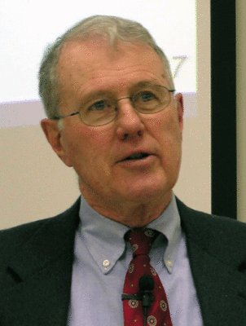
Major Prophets
Lecture 14: Isaiah 40 Overture, Servant of the Lord Theme
Dr. Robert Vannoy
ReNarrated by Dr. Perry Phillips
© 2023 Robert Vannoy & Ted Hildebrandt

Slide 2
Major Prophets
Isaiah 40 Overture Introduction
Isaiah 40:1-2 Comfort to Jerusalem
“Double” (?) or Substitute/Equivalent
Isaiah 40:3-5 God’s Deliverance
John the Baptist Reference [Lk. 3:4-6; Mt. 3:1-3; Mk. 1:2-3; Jn 1:19-23]
Isaiah 40:6-8 Message to Be “Cried Out”
Isaiah 40:9 God Brings Deliverance
Isaiah 40:10-11 The Greatness of His Deliverance
Isaiah 40:12 Transition
Who Created the Universe?

Slide 3
Major Prophets
Isaiah 40:13-14 Who Was God’s Helper at Creation?
Isaiah 40:15-17 The Nations Are as Nothing
Isaiah 40:18-20 Theme of Idolatry and the Futility of Idolatry
Isaiah 40:40:21-24 God is the Lord of Nature and History
Isaiah 40:25-27 To Whom Will You Compare Me? Lord is Incomparable
Isaiah 40:28-31
Servant of the Lord Theme: Four Servant Psalms
1. Isaiah 41:8 Israel, you are my servant
2. Isaiah 42:1-7 The Work the Servant Will Do
Questions Arising -- How Can Israel Do that When Israel Herself is a
Prisoner? Isaiah 42:19-24

Slide 4
Major Prophets
Video based on audio from Dr. Vannoy’s class at Biblical Theological
Seminary. It was renarrated by Dr. Perry Phillips because the original audio
was scratchy and it was turned into video by Ted Hildebrandt for Biblicalelearning.org.

