Slide 1

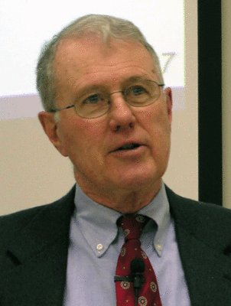
Major Prophets
Lecture 13: Authenticity Arguments, Major Themes
Dr. Robert Vannoy
ReNarrated by Dr. Perry Phillips
© 2023 Robert Vannoy & Ted Hildebrandt

Slide 2
Major Prophets
Review of Deutero-Isaiah Arguments and Responses
Relevance of Isaiah 40-66 for Isaiah’s Contemporary Audience [Judgment/exile→ Comfort]
Isaiah 36-39 Hezekiah and Merodach-Baladan of Babylon
Micah’s Prediction of a Babylonian Exile [not Assyrian]
Arguments for Authenticity
  1. No Manuscript Evidence that the Book ever Existed in Anything but a Unified Form
  2. The New Testament Witness Supports Isaiahanic Authorship
Critical Multiplication of Isaiahs
Josiah’s Reformation

Slide 3
Major Prophets
B. Isaiah 40-66 – The Symphonic Structure as Themes Move Back and Forth
  No Logical Arrangement – More Like a Musical Composition
Major Themes of Isaiah 40-66
  1. Comfort
  2. God’s Power
  3. Futility of Idolatry
  4. God’s Omniscience
  5. The Servant of the Lord
Video based on audio from Dr. Vannoy’s class at Biblical Theological
Seminary. It was renarrated by Dr. Perry Phillips because the original audio
was scratchy and it was turned into video by Ted Hildebrandt for Biblicalelearning.org.

