Slide 1

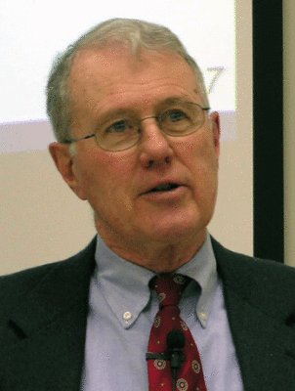
Major Prophets
Lecture 10: Isaiah 28-30
Dr. Robert Vannoy
ReNarrated by Dr. Perry Phillips
© 2023 Robert Vannoy & Ted Hildebrandt

Slide 2
Major Prophets
Review
Isaiah 28:8-13 Nobles Mock Isaiah – Isaiah Respond’s – A Foreign Tongue Will
Teach Them
Isaiah 28:14-22 Address to Jerusalem Nobles Alliance with Assyria
God’s Foundation Stone [Messiah]
“Make Haste” or “Make Ashamed” (cf. Rom. 9:33)
Isaiah 28:17 River Overflows the Hiding Place
Isaiah 28:18-20 Covenant With Death = Impossibility of Human Sources of
Security
Isaiah 28:21-22 God’s Judgment on Israel
Isaiah 28:23-29 God Plans as a Farmer Does

Slide 3
Major Prophets
Isaiah 29:1 Ariel – Lion or Hearth/Fireplace
The Lord Will Protect Judah
Isaiah 29:9-12 Turned Away From the Lord and His Word
Isaiah 29:13-24 Israel Plots with Assyria, They Pretend they are the Potter
Isaiah 29:17 Lebanon Turned into a Fertile Field [not Israel]
Isaiah 29:18 Those Outside the Covenant Brought In
Isaiah 29:19-22
Isaiah 29:22-23
Isaiah 29:24 Turning of Gentiles to God
Isaiah 29:19-21 Weakening Influence of Evil as Gospel Spreads

Slide 4
Major Prophets
Isaiah 29:20-21
Key Interpretive Issue: “Fruitful Field” Symbol of Weakness or God’s Cultivation
Video based on audio from Dr. Vannoy’s class at Biblical Theological
Seminary. It was renarrated by Dr. Perry Phillips because the original audio
was scratchy and it was turned into video by Ted Hildebrandt for Biblicalelearning.org.

