Slide 1

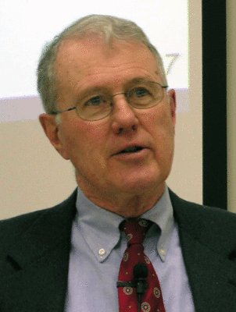
Major Prophets
Lecture 7: Isaiah 8:11-10:32
Dr. Robert Vannoy
ReNarrated by Dr. Perry Phillips
© 2023 Robert Vannoy & Ted Hildebrandt

Slide 2
Major Prophets
Isaiah 8:11-9:3 Exhortation to the Israelites – Isa. 8:11-22
  Distress to Joy
  Historical Context – 2 Kings 15:29-30
Isaiah 9:2-3: Immanuel’s Coming
  Why joy in Isaiah 9:3? – 3 Reasons
Isaiah 9:7 Davidic Reign
  How does it relate to the Millennium
Isaiah 9:8-10:4 4 Stanzas of Poetry each ending with “his anger…”
Isaiah 10:5 Judgment/Consolation cycles give way to Assyrians as God’s
Instrument
Isaiah 10:15 Boasting Ax Metaphor [Assyria]

Slide 3
Major Prophets
Isaiah 10:16-19 Forest Image of Destruction of Assyria
Isaiah 10:20-23 Remnant Returns
Isaiah 10:24-27 Judah Will Not Be Conquered by Assyria
Isaiah 10:28-32 Closing in on Jerusalem but God Intercedes
Summary of Isaiah 10
Video based on audio from Dr. Vannoy’s class at Biblical Theological
Seminary. It was renarrated by Dr. Perry Phillips because the original audio
was scratchy and it was turned into video by Ted Hildebrandt for Biblicalelearning.org.

