Slide 1

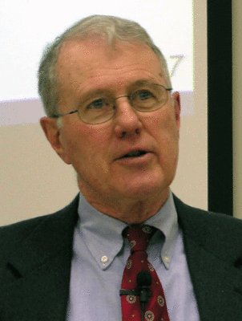
Kings
Lecture 11: Elijah, the Widow of Zarephath, and redemptive History, 1 Kings 17
Dr. Robert Vannoy
ReNarrated by Dr. Perry Phillips
© 2023 Robert Vannoy & Ted Hildebrandt

Slide 2
Kings
Reading the Text of 1 Kings 17:7-24
The Principle of Replacement Set in Operation – 1 Kings 17:7-24
Elijah’s Relocation from Brook Kerith to Zarephath
F. B. Meyer’s anthropocentric book on Elijah
Promise Given to the Widow
Going Beyond Imitation to Redemptive History
Death of the Widow’s Son in Preaching
Why did the Lord Take the Boy’s Life? – her sin?
Elijah Ministers to the Widow who Fed Him

Slide 3
Kings
  Boy Brought Back to Life
  First Resurrection in Scripture
  Video based on audio from Dr. Vannoy’s class at Biblical Theological
  Seminary. It was renarrated because the original audio was scratchy
  and it was turned into video by Ted Hildebrandt for Biblicalelearning.org.

