Slide 1

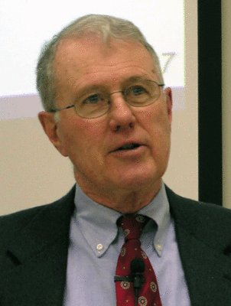
Kings
Lecture 10: Prophet out of Judah, Ahijah’s Warning, Baasha’s Dynasty, Omri & Ahab
Dr. Robert Vannoy
ReNarrated by Dr. Perry Phillips
© 2023 Robert Vannoy & Ted Hildebrandt

Slide 2
Kings
    Review – 1 Kings 13 – Prophet out of Judah
    Elisha, the Taunting Youths, and the Bears
  d. Ahijah’s Warning to Jeroboam – 1 Kings 14
  e. Nadab’s Reign – 1 Kings 15:25-28
2. The Dynasty of Baasha
a. Baasha’s Succession
  b. Baasha’s Wars Against Judah – 1 Kings 15:32
  c. Jehu’s Prophesy – 1 Kings 16:1-7
  d. Elah’s Reign – 1 Kings 16:8

Slide 3
Kings
  e. Zimri’s Usurpation – 1 Kings 16:9-13
  f. Interregnum, 4 Years
D. The Dynasty of Omri
1. Omri Himself – 1 Kings 16:15-28
a. Succession – 1 Kings 16:21-22
b. His New Capital – Samaria – 1 Kings 16:24
    c. His Statesmanship
    d. His Importance

Slide 4
Kings
  2. Ahab – 1 Kings 16-22
    a. Ahab’s Person – 1 Kings 16:29-34
    Jericho
    b. Jezebel, Ahab’s Wife – 1 Kings 16:31
    Elijah and Elisha
  Video based on audio from Dr. Vannoy’s class at Biblical Theological
  Seminary. It was renarrated because the original audio was scratchy
  and it was turned into video by Ted Hildebrandt for Biblicalelearning.org.

