Slide 1

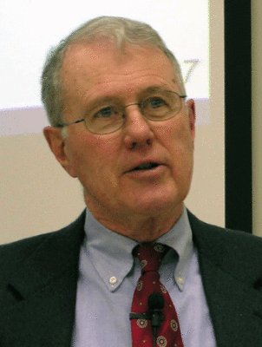
Kings
Lecture 6: Solomon’s Peace with Flaws
Dr. Robert Vannoy
ReNarrated by Dr. Perry Phillips
© 2023 Robert Vannoy & Ted Hildebrandt

Slide 2
Kings
F. 1. Peace with a Flaw – 1 Kings 9:10-25 – Giving Away God’s Land
Avoiding Disillusionment and Cynicism with the Church
Gezer and Canaanite Pockets that Remained
Queen of Sheba & Gold
Solomon and Deuteronomy 17 [kingship] and Gold
Solomon’s Throne
Solomon’s Kingdom of Peace with Flaws [syncretism]

Slide 3
Kings
Video based on audio from Dr. Vannoy’s class at Biblical Theological
Seminary. It was renarrated because the original audio was scratchy
and it was turned into video by Ted Hildebrandt for Biblicalelearning.org.

