Slide 1

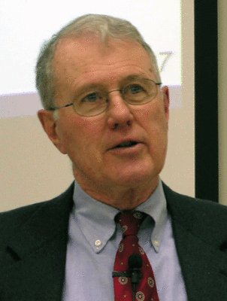
Kings
Lecture 2: 1 Kings 1-2, Kingship, David-Solomon Succession
Dr. Robert Vannoy
ReNarrated by Dr. Perry Phillips
© 2023 Robert Vannoy & Ted Hildebrandt

Slide 2
Kings
Course Instructions
I. United Kingdom under Solomon
A. Introductory Material
1. Solomon’s Succession to the Throne -- 1 Kings 1:1-2:12
  a. Solomon’s Birth and Birth Order
  b. Adonijah: Resistance to God’s Designated Successor
  c. Plot Countering Adonijah – 4 Conversations
  1. Nathan and Bathsheba
    2. Bathsheba and David
    3. Nathan and David
    4. David and Bathsheba

Slide 3
Kings
  5. Adonijah’s Response
D. Profile of a Covenantal King: David’s Charge to Solomon
E. Kingship
  1. Saul and Kingship
  2. David and Kingship
  3. King Under Yahweh
  4. Redemptive Historical Perspective and Its Relevance
F. I Kings 2:5-12 David’s Instructions on 3 People: Joab, Barzillai & Shimei
  1. Joab

Slide 4
Kings
Video based on audio from Dr. Vannoy’s class at Biblical Theological
Seminary. It was renarrated because the original audio was scratchy
and it was turned into video by Ted Hildebrandt for Biblicalelearning.org.

