Slide 1

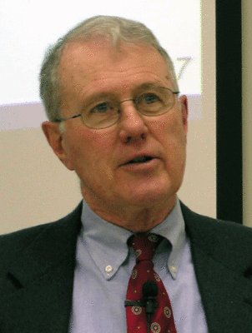
Genesis
Lecture 30: Joseph’s Coming to Egypt pre-Hyksos
Dr. Robert Vannoy
ReNarrated by Ted Hildebrandt
© 2023 Robert Vannoy & Ted Hildebrandt

Slide 2
Genesis
Map Assignment
When Did Joseph Enter Egypt?
Argument for Joseph’s Coming to Egypt Prior to the Hyksos
1. The Sentiment of the Egyptian Government in Joseph’s Time as
strongly Adverse to Shepherds
2. New King Who Knew Not Joseph was a Native Egyptian
3. Exodus 1:10 The Israelites Have Become Much Too Numerous for Us
Tentative Conclusion

Slide 3
Genesis
Video based on audio from Dr. Vannoy’s class at Biblical Theological
Seminary. It was renarrated because the original audio was scratchy
and it was turned into video by Ted Hildebrandt for Biblicalelearning.org.

