Slide 1

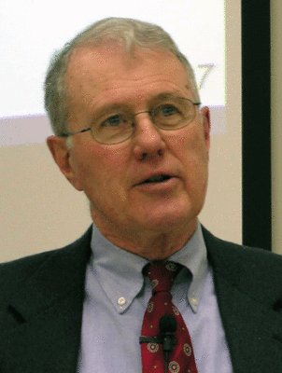
Genesis
Lecture 28: Jacob’s Blessing of Judah, Joseph
Dr. Robert Vannoy
ReNarrated by Ted Hildebrandt
© 2023 Robert Vannoy & Ted Hildebrandt

Slide 2
Genesis
Opening Comments
F. Jacob …
3. Jacob at Peniel – Genesis 32
4. The Loss of Joseph – Genesis 37
  5. Jacob’s Blessings in Genesis 49
  Judah’s Blessing (Gen. 49:8-12)
  Early Mention of Kingship
  Until “Shiloh” Comes (?) – Genesis 49:10
  Intertextual Connection to Ezek. 21:27
  Davidic King and Christ [Already but not Yet]

Slide 3
Genesis
G. Joseph
1. Genesis 37:2 – Toledoth
  2. The Events of Joseph’s Life
  3. Joseph’s Encounters with His Brothers – Genesis 42-45
  Joseph’s Family Dreams
  NT does not Mention Joseph as a Type of Christ
3. The Significance of These Events in the Context of Redemptive History
Joseph Temporarily Become Prominent, although Judah is the
Promised Seed.
Genesis 38 – Judah and Tamar
Perez in Christ’s Line

Slide 4
Genesis
  Video based on audio from Dr. Vannoy’s class at Biblical Theological
  Seminary. It was renarrated because the original audio was scratchy
  and it was turned into video by Ted Hildebrandt for Biblicalelearning.org.

