Slide 1

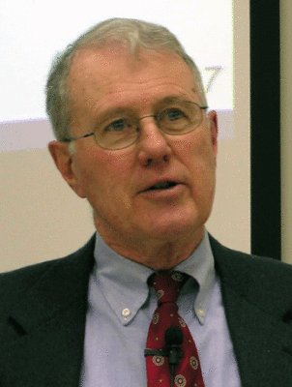
Genesis
Lecture 27: Jacob Marriages to Peniel (Gen. 29-32)
Dr. Robert Vannoy
ReNarrated by Ted Hildebrandt
© 2023 Robert Vannoy & Ted Hildebrandt

Slide 2
Genesis
F. Jacob …
2. The Years at Haran, Gen. 29-31
Law Against Marrying the Sister (Lev. 18:18)
Difficulty in Jacob’s Polygamous Marriages
Mandrakes
God Gives Rachel a Son – Joseph
The Multiplication of the Seed of Abraham
Joseph’s Sons – Ephraim and Manasseh
Ambiguity in Counting the 12 Tribes
Jacob Acquires Wealth

Slide 3
Genesis
Rachel Steals Her Father Laban’s Household God
3. Jacob and Peniel – Genesis 32
Jacob Prepares to Meet Esau
Jacob Wrestles with the Angel of the Lord
Name Change: Jacob → Israel
Jacob’s Pleading for a Blessing
Mahanaim
  Video based on audio from Dr. Vannoy’s class at Biblical Theological
  Seminary. It was renarrated because the original audio was scratchy
  and it was turned into video by Ted Hildebrandt for Biblicalelearning.org.

