Slide 1

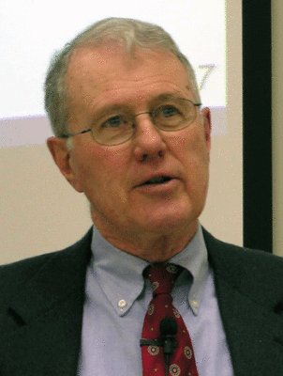
Genesis
Lecture 26: Isaac/Rebekah and the Early Life of Jacob
Dr. Robert Vannoy
ReNarrated by Ted Hildebrandt
© 2023 Robert Vannoy & Ted Hildebrandt

Slide 2
Genesis
E. Isaac
1. His Birth – Gen. 17, 18 and 21
  2. Isaac being Offered – Genesis 22
  3. His Marriage in Genesis 24
  4. His Sons – Jacob/Esau
  5. The Covenant is Reaffirmed to Isaac, Gen. 26:1-5
  Isaac is Deceived by His Wife and Son – Gen. 27
  God Accomplishes His Will in Spite of Isaac’s Failure of Faith
  Esau’s Response and Esau’s “blessing”
  Isaac’s Last Days

Slide 3
Genesis
F. Jacob
1. Jacob at Bethel
Jacob’s Blessing Repeated
Jacob at Bethel [Jacob’s Ladder]
  2. The Years at Haran – Genesis 29-31
  Jacob, Rachel and Leah
  Video based on audio from Dr. Vannoy’s class at Biblical Theological
  Seminary. It was renarrated because the original audio was scratchy
  and it was turned into video by Ted Hildebrandt for Biblicalelearning.org.

