Slide 1

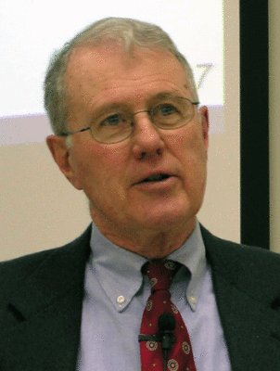
Genesis
Lecture 23: Abrahamic Covenant – Gen 15, 17 and Akedah (Gen. 22)
Dr. Robert Vannoy
ReNarrated by Ted Hildebrandt
© 2023 Robert Vannoy & Ted Hildebrandt

Slide 2
Genesis
Genesis 15 and the Smoking Furnace
Extent of the Promised Land
Abraham and the New Covenant
Genesis 17 – Covenant Renewed and Confirmed
Abram to Abraham
Fourth Covenant Reiteration -- Genesis 22:17-18
Abraham’s Response — Obedience
God’s Sovereignty and Human Responsibility
Genesis 18:9-14 Circumcision – Sign of the Covenant
Circumcision of the Heart

Slide 3
Genesis
Genesis 22 – Akedah, Binding of Isaac Discussion
Video based on audio from Dr. Vannoy’s class at Biblical Theological
Seminary. It was renarrated because the original audio was scratchy
and it was turned into video by Ted Hildebrandt for Biblicalelearning.org.

