Slide 1

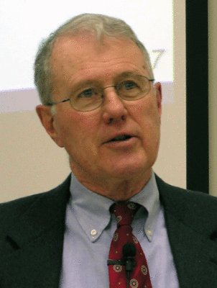
Genesis
Lecture 22: Abrahamic Covenant – Gen. 12, 15, …
Dr. Robert Vannoy
ReNarrated by Ted Hildebrandt
© 2023 Robert Vannoy & Ted Hildebrandt

Slide 2
Genesis
Deuteronomy Assignment for Class
Abraham as an Historical Figure
1. Abraham and the Philistines
2. Abraham as Our Spiritual Father
a. God’s Covenant with Abraham
Genesis 12:1-3 – passive or reflexive
Genesis 12:7 the Gift of the Land
Other Abrahamic Covenant Passages: Land Promised
Genesis 15 Ratification of the Covenant
Oath Covenant Ritual: Cut a Covenant Vision of the Smoking
Furnace Passing Between Parts

Slide 3
Genesis
Video based on audio from Dr. Vannoy’s class at Biblical Theological
Seminary. It was renarrated because the original audio was scratchy
and it was turned into video by Ted Hildebrandt for Biblicalelearning.org.

