Slide 1

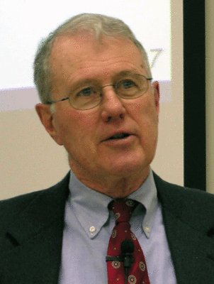
Genesis
Lecture 19: Archaeology, Patriarchal Period
Dr. Robert Vannoy
ReNarrated by Ted Hildebrandt
© 2023 Robert Vannoy & Ted Hildebrandt

Slide 2
Genesis
Archaeology and Biblical History
Tentative Nature of Interpretation of Archaeological Data
Archaeological Resources
V. Genesis 11:27-Genesis 50
  Genesis 11:27 Division
  A. Authenticity of the Patriarchal Accounts
    1. Minimalist Approach to Patriarchal History: Thompson and Van Seters
    Nuzi, Mari and other Early Texts and the Patriarchal Period
    Ebla Texts
    Patriarchal Names

Slide 3
Genesis
Video based on audio from Dr. Vannoy’s class at Biblical Theological
Seminary. It was renarrated because the original audio was scratchy
and it was turned into video by Ted Hildebrandt for Biblicalelearning.org.

