Slide 1

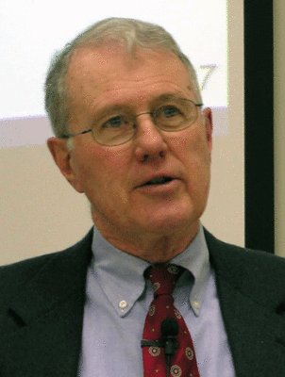
Genesis
Lecture 17: Curse on Canaan, Table of Nations, Babel
Dr. Robert Vannoy
ReNarrated by Ted Hildebrandt
© 2023 Robert Vannoy & Ted Hildebrandt

Slide 2
Genesis
Curse on Canaan (Gen. 9:25-26)
Line of Shem
Line of Japheth
Return to Curse on Canaan
F. The Table of Nations in Genesis 10
  Nimrod
  Who was the Initial Audience?
  How did Moses Get His Information?
G. The Tower of Babel and the Confusion of Tongues (Gen. 11:1-9)
  Why did God Intervene at the Tower of Babel?

Slide 3
Genesis
Purpose of the Tower of Babel
Confusion of the Languages
Video based on audio from Dr. Vannoy’s class at Biblical Theological
Seminary. It was renarrated because the original audio was scratchy
and it was turned into video by Ted Hildebrandt for Biblicalelearning.org.

