Slide 1

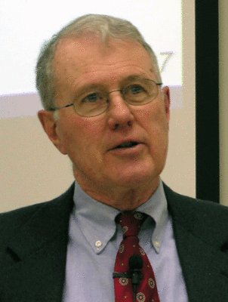
Genesis
Lecture 16: The Flood Narrative (Gen. 6-9) and Mesopotamian Parallels
Dr. Robert Vannoy
ReNarrated by Ted Hildebrandt
© 2023 Robert Vannoy & Ted Hildebrandt

Slide 2
Genesis
1. Babylonian Floor Story
  Similarities
  Explanation of Parallels
  a. Mesopotamian Account Was Borrowed from a Proto-Semitic/Biblical
  Account
  b. The Hebrews Borrowed Their Account from the Mesopotamians
  c. Von Rad’s Analysis – Both Independent with a Common Source
  d. A Common Source of National Occurrence
6. Conditions Governing the Post-Deluvian World
a. The Directions for the Propagation and Maintenance of Human and
Animal Life

Slide 3
Genesis
    b. Dominion of Man over the Animals is Reconfirmed
    c. They were to be Fruitful and Multiply & Sacredness of Human Life
2. The Noahic Covenant in Genesis 9:8-17
7. The Curse on Canaan
  a. Ham and Slavery
  b. Curse on Canaan
  What Was Ham’s Offense?
Video based on audio from Dr. Vannoy’s class at Biblical Theological
Seminary. It was renarrated because the original audio was scratchy
and it was turned into video by Ted Hildebrandt for Biblicalelearning.org.

