Slide 1

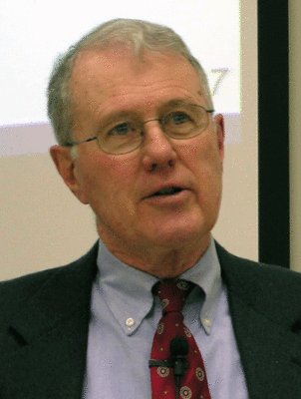
Genesis
Lecture 15: The Flood Narrative (Gen. 6-9)
Dr. Robert Vannoy
ReNarrated by Ted Hildebrandt
© 2023 Robert Vannoy & Ted Hildebrandt

Slide 2
Genesis
E. Flood Story
1. The Extent of the Flood
2. The Duration of the Flood
  3. The Cause of the Flood
  4. Sons of God & Daughters of Men – Gen. 6:1-4
    a. Mythological Approach
    b. Angels View
    c. Sethite View
    d. Kingship View
    Violence Factor

Slide 3
Genesis
5. Historicity of the Flood
  Babylonian Flood Stories
  Difference between the Biblical and Babylonian Flood Stories
Video based on audio from Dr. Vannoy’s class at Biblical Theological
Seminary. It was renarrated because the original audio was scratchy
and it was turned into video by Ted Hildebrandt for Biblicalelearning.org.

