Slide 1

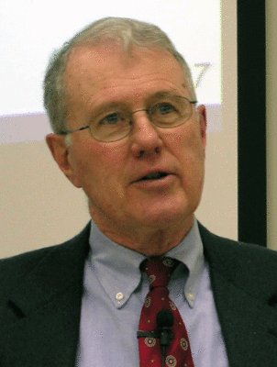
Genesis
Lecture 14: Genesis 4-5 – Cain and Abel
Dr. Robert Vannoy
ReNarrated by Ted Hildebrandt
© 2023 Robert Vannoy & Ted Hildebrandt

Slide 2
Genesis
Genesis 4-5
1. The Death of Abel
  2. Offerings of Cain and Abel
    Warfield on Cain’s Offering – Piacular versus gift
    John Murray’s approach to Gen. 4— “More Excellent Sacrifice”
    Gen. 4:7 “Sin lies at the Door”
    Gen. 4:9 God’s Response “Where is Abel Your Brother?”
    First Curse on a Human – Can’s Curse
2. Antediluvian Technology
  Where did Cain Get His Wife?

Slide 3
Genesis
Capital Offense and Capital Punishment
Video based on audio from Dr. Vannoy’s class at Biblical Theological
Seminary. It was renarrated because the original audio was scratchy
and it was turned into video by Ted Hildebrandt for Biblicalelearning.org.

