Slide 1

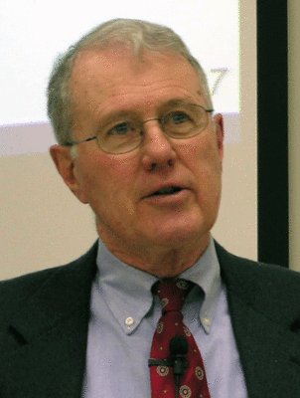
Genesis
Lecture 13: Genesis 4-5
Dr. Robert Vannoy
ReNarrated by Ted Hildebrandt
© 2023 Robert Vannoy & Ted Hildebrandt

Slide 2
Genesis
Genesis 4-5 …
2. Antediluvian Technology or Technology Prior to the Flood
  3. The Line of Cain
  Christianity and Culture
  4. The Genealogy of Seth
    a. Its Purpose and His Character

Slide 3
Genesis
Video based on audio from Dr. Vannoy’s class at Biblical Theological
Seminary. It was renarrated because the original audio was scratchy
and it was turned into video by Ted Hildebrandt for Biblicalelearning.org.

