Slide 1

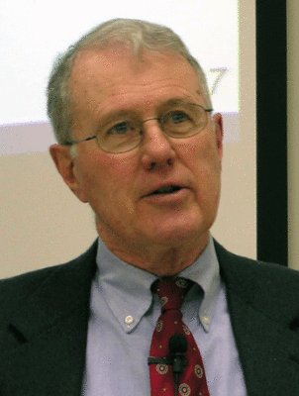
Genesis
Lecture 11: Genesis 3 – The Fall
Dr. Robert Vannoy
ReNarrated by Ted Hildebrandt
© 2023 Robert Vannoy & Ted Hildebrandt

Slide 2
Genesis
Genesis 3
1. Its Place in History
  2. The Details of the Fall
  a. The Nature of the Test
    b. The Serpent
Video based on audio from Dr. Vannoy’s class at Biblical Theological
Seminary. It was renarrated because the original audio was scratchy
and it was turned into video by Ted Hildebrandt for Biblicalelearning.org.

