Slide 1

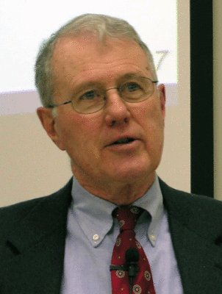
Genesis
Lecture 10: Creation of Woman, Evolutionary Theory
Dr. Robert Vannoy
ReNarrated by Ted Hildebrandt
© 2023 Robert Vannoy & Ted Hildebrandt

Slide 2
Genesis
Genesis 2…
4. Creation of Woman
a. The Need Demonstrated
  b. Adam’s “rib” or “side”
  c. Adam and the Unity of Humankind
  d. Gen 2:24 Narrator’s Comment: Explanation or Command
5. What about Evolution?
  a. Difficulty in Progressing beyond Darwinism: Intransigence
  b. Carl Henry on Evolutionary Theory

Slide 3
Genesis
  Video based on audio from Dr. Vannoy’s class at Biblical Theological
  Seminary. It was renarrated because the original audio was scratchy
  and it was turned into video by Ted Hildebrandt for Biblicalelearning.org.

