Slide 1

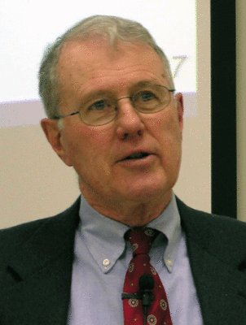
Genesis
Lecture 9: Genesis 2 – The two trees in the Garden
Dr. Robert Vannoy
ReNarrated by Ted Hildebrandt
© 2023 Robert Vannoy & Ted Hildebrandt

Slide 2
Genesis
3. Garden of Eden…
b. The Trees of the Garden
1. The Tree of Life
  Tree of Life as Sacramental Symbol
  Comments on Sacraments
  Tree of Life in Revelation
2. The Tree of the Knowledge of Good and Evil
a. Gen 2-3 Text on the Tree
  b. Mythical View of the Tree
  Vos’ view of the Tree

Slide 3
Genesis
  Vannoy’s Response on Vos’ View of the Tree: Self-Deification View
  Bavink’s View of the Tree
  Video based on audio from Dr. Vannoy’s class at Biblical Theological
  Seminary. It was renarrated because the original audio was scratchy
  and it was turned into video by Ted Hildebrandt for Biblicalelearning.org.

