Slide 1

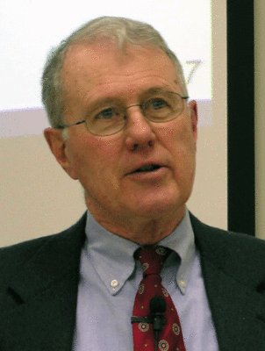
Genesis
Lecture 8: Genesis 2 in Context
Dr. Robert Vannoy
ReNarrated by Ted Hildebrandt
© 2023 Robert Vannoy & Ted Hildebrandt

Slide 2
Genesis
1. Is Genesis 2 Another Account of Creation?
  Vannoy’s Approach to Genesis 2
  a. The Use of the Word “toledoth” and Chapter Division Issue
  b. What is the Function of Genesis 2 in Relation to Genesis 3?
  1. Chapter 2 is to Center Attention on Man in Preparation for the Account
  of the Fall
    2. Does Genesis 2 Contradict Genesis 1?
    3. Genesis 2:19 Does Not Say That Animals Were Created After Man
    and Not Woman
  Parallel of Genesis 2:5-6 and Genesis 1:2

Slide 3
Genesis
  3. The Garden of Eden
  a. Its Geographic Location
  Video based on audio from Dr. Vannoy’s class at Biblical Theological
  Seminary. It was renarrated because the original audio was scratchy
  and it was turned into video by Ted Hildebrandt for Biblicalelearning.org.

