Slide 1

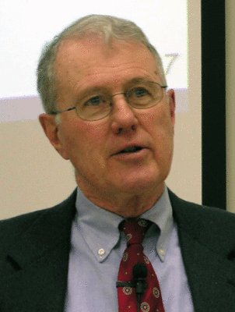
Genesis
Lecture 7: Literary Framework of Genesis 1, Mesopotamian Creation Stories – Enuma Elish
Dr. Robert Vannoy
ReNarrated by Ted Hildebrandt
© 2023 Robert Vannoy & Ted Hildebrandt

Slide 2
Genesis
Literary Framework Hypothesis: Vannoy’s Objections
A. The Creation of the Universe Continued
7. How was the Knowledge of Genesis 1 Imparted?
Apparent Age Argument Debunked
  How Has the Knowledge of Genesis 1 Been Imparted?
  Babylonian Origins Texts – Pan-Babylonian School
  Enuma Elish

Slide 3
Genesis
  Video based on audio from Dr. Vannoy’s class at Biblical Theological
  Seminary. It was renarrated because the original audio was scratchy
  and it was turned into video by Ted Hildebrandt for Biblicalelearning.org.

