Slide 1

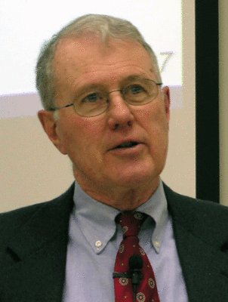
Genesis
Lecture 6: Genesis 1 “Days” [Yom] – Theories of Interpretation
Dr. Robert Vannoy
ReNarrated by Ted Hildebrandt
© 2023 Robert Vannoy & Ted Hildebrandt

Slide 2
Genesis
Yom [day]
a. Usage
1. Usage in the OT in General
2. Usage in Genesis 1 Framework
    3. Length of the Seventh Day is a Long Period
      a. Argument for a Solar Day Based on Exod. 20 analogy
    Differing Opinions Allowed
  b. Main Types of Views of the Days of Genesis 1
    Perspective on the Length of “days” in Gen. 1
    1) 3 Approaches for Actual Days
    Vannoy’s Position

Slide 3
Genesis
b. 24-hour Solar Day Position
c. Day Age Theory
Comments on the Relationship between Science and the Bible
2. Non-Actual Days
  a. Symbolic or Logical Order Days
  b. Augustine’s Allegorical View of “Day”
  c. Revelational Day
  d. Framework Hypothesis: “Day” as a Literary Device
  Parallelism of Days 1-3 & 4-6

Slide 4
Genesis
  Video based on audio from Dr. Vannoy’s class at Biblical Theological
  Seminary. It was renarrated because the original audio was scratchy
  and it was turned into video by Ted Hildebrandt for Biblicalelearning.org.

