Slide 1

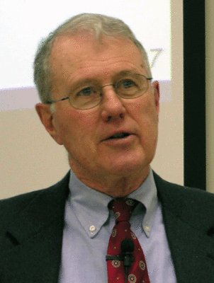
Genesis
Lecture 5: Genesis 1 and God, Genesis 1:1-2
Dr. Robert Vannoy
ReNarrated by Ted Hildebrandt
© 2023 Robert Vannoy & Ted Hildebrandt

Slide 2
Genesis
  c. God is the Omnipotent Creator of the Universe
  d. God is Separate from His Creation
2. General Teachings about the Universe
a. The Universe is not Self-Existent or Divine
b. It is Not Inherently Evil or Antagonistic to God and Man
  c. The Universe Came into Being at the Will of the Divine Creator
  d. Its Formation Follows Orderly Stages
3. Genesis 1-2’s General Teaching About Man
a. The Same as With the Universe, Man is Not Self-Existent or Divine
b. Man Owes His Existence to a Creative Act of God
c. Man Comes as the Culmination of the Creative Acts of God
d. Man is Separate from All the Rest of God’s Creation

Slide 3
Genesis
  e. Man Has Divine Authority or Dominion over the Animal Creation and is
  Given the Task of Subduing the Earth
4. Interpretations of Genesis 1:1
  a. Genesis 1:1 Taken as an Independent Clause
  1. Genesis 1:2 “was” or “became”
  Gap Theory Debunked – Weston Fields
  2. There’s No Real Link Established with Genesis 1:2 even if Those
  Passages are Talking about Satan
  3. The Third Possibility is that the Statement Refers to the Creation of
  Matter
  b. Genesis 1:1 as an Independent Clause / Subordinate Clause views

Slide 4
Genesis
  Genesis 1:2 as a Parenthesis(?)
  Video based on audio from Dr. Vannoy’s class at Biblical Theological
  Seminary. It was renarrated because the original audio was scratchy
  and it was turned into video by Ted Hildebrandt for Biblicalelearning.org.

