Slide 1

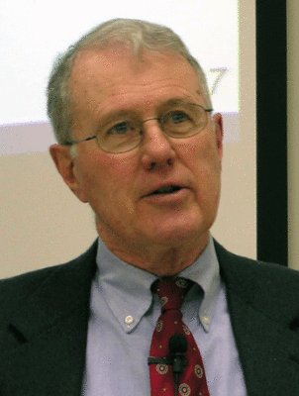
Genesis
Lecture 1: Wellhausen [Source Criticism], Gunkel [Form Criticism]
Dr. Robert Vannoy
ReNarrated by Ted Hildebrandt
© 2023 Robert Vannoy & Ted Hildebrandt

Slide 2
Genesis
Review: Wellhausen’s Documentary Source Hypothesis [JEDP]
  Polytheism to Henotheism to Monotheism
  Natural to Prophetic to Priestly Religion
  Impact on Historicity
  Wellhausen’s Resignation
  Result of the History of Religions Evolutionary Model
B. The Rise of Form Criticism
  1. General Comments on Form Criticism
    Oral Traditions Behind Source Documents
    Hermann Gunkel (1862-1932)

Slide 3
Genesis
2. Gunkel’s Terms: Gattung/Genre, Sitz im Leben and Formgeschichte
3. Form Criticism Methodology
4. Gunkel and Chronology
5. Orality to Written Composition
6. Gattung to Sitz im Leben
  Benefits
  Higher and Lower Criticism
7. Gunkel’s Myths and Legends Story Units and Sitz im Leben
8. Relationship of Legend to History
9. Christ & Apostles no bearing on History of Genesis Narratives
10. A Priori Deleting of the Miraculous Elements

Slide 4
Genesis
11. Legend as Poetry
12. Genesis as Etiological Legends
13. Examples of Etymological Legends
14. Ceremonial Legends
15. Geological Legends
16. Magnificent Stories but Dismisses Them as Actual History
Video based on audio from Dr. Vannoy’s class at Biblical Theological
Seminary. It was renarrated because the original audio was scratchy
and it was turned into video by Ted Hildebrandt for Biblicalelearning.org.

