Slide 1
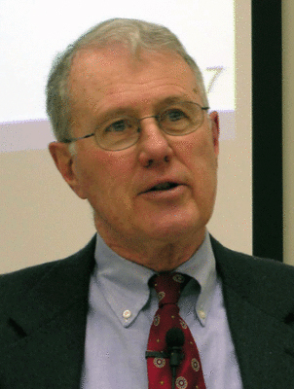
Foundations of Biblical Prophecy
Lecture 9 True and False Prophets
Dr. Robert Vannoy
ReNarrated by Ted Hildebrandt © 2023 Robert Vannoy & Ted Hildebrandt

Slide 2
Foundations of Biblical Prophecy
VI. Validation Criteria for True Prophecy
A. B. C. Review
4. Conformity of the Message to Previous Revelation
a. Deuteronomy 13
b. Jeremiah 28
c. Isaiah 8:19-20
d. Objections to this Criterion?
1. Unveiling of New Things
2. It’s not adequate for Testing Specific Details of Particular Prophecies
3. Authority is Impossible to Verify

Slide 3
Foundations of Biblical Prophecy
Student Question: Ezekiel 18 Sins of Fathers visited on Children contra Exodus 20
4. Short Term Prophecy Verifies Long Term Jer. 26-28
5. Enlightenment by God’s Spirit
a. Deut. 29:2-4
B. Present Application
1. Vos: Objective and Subjective Aspects
2. Bavinck Revelation Reached its End in Christ
3. Modern Application

Slide 4
Foundations of Biblical Prophecy
VII. The Prophet and the Cult in Ancient Israel
A. The View That The Prophets Were Anti-Cultic
1. The View That Prophets Were Anti-Cultic
2. Scripture Adduced for Support of the View that the Prophets Were Opposed to the Cult
Video based on audio from Dr. Vannoy’s class at Biblical Theological Seminary. It was renarrated because the original audio was scratchy and it was turned into video by Ted Hildebrandt for Biblicalelearning.org.

