Slide 1

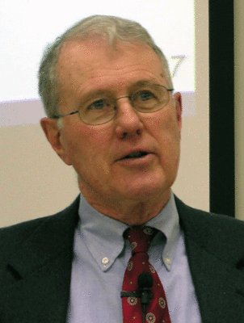
Foundations of Biblical Prophecy
Lecture 7 The Ways and Means of God’s
Revelation to the Prophets
Dr. Robert Vannoy
ReNarrated by Ted Hildebrandt
© 2023 Robert Vannoy & Ted Hildebrandt

Slide 2
Foundations of Biblical Prophecy
  IV. The Ways and Means of God’s Revelation to the Prophets
    C. In What Sense May We Speak of Ecstasy Among Israel’s Prophets
      3. Certainly Not Everything Labeled as Ecstatic Behavior on the Part of Canonical Prophets Can Be Considered Such
      Being labeled as “mad”
      4. The Form of Ecstatic Behavior Most Frequently Displayed Among Israel’s Prophets is that of the Visionary Experience, not Wild Abnormal Behavior
        a) Biblical Prophecy and Visions
        b) What is a Vision?
        c) Biblical Ecstasy

Slide 3
Foundations of Biblical Prophecy
  V. The Preaching of the Prophets
    A. General Remarks
      1. The Prophets Were First and Foremost Proclaimers of God’s Word
      2. The Message of the Prophets was a Faithful Proclamation of God’s Revelation
        a) Vos
        b) Early and Later Berkouwer
    B. Some Formal Characteristics of the Prophetic Proclamation
      1. The Messages Are Direct and Living – Not Abstract and Dry
        a) Jeremiah 7 – Jeremiah’s Temple Sermon
        b) Joel 2, Nahum

Slide 4
Foundations of Biblical Prophecy
    2. The Prophets Often Utilized a Play on Words to Get a Point Across
      a) Isaiah 5:7
      b) Isaiah 7:9
      c) Jer. 23:33
      d) Jer. 1:11
    3. The Prophets Often Utilize Poetic Expression
    4. The Prophets All Tend to Use Imagery or Figurative Language
      a) Isaiah 28
      b) Isaiah 5 Song of the Vineyard
      c) Ezekiel 27

Slide 5
Foundations of Biblical Prophecy
  C. Some Characteristics of the Content of Prophetic Writings
    1. The Prophets Do Not Bring a New Religion or Morality
    2. The Message of the Prophets is Centered in Four Areas
      a) Religious or Theological
      b) Morality and Social Relationships
      Video based on audio from Dr. Vannoy’s class at Biblical Theological Seminary. It was renarrated because the original audio was scratchy
      and it was turned into video by Ted Hildebrandt for Biblicalelearning.org.

