Slide 1

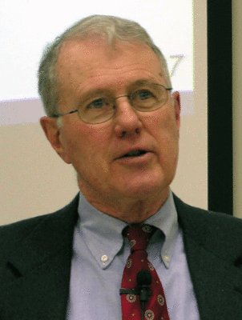
Foundations of Biblical Prophecy
Lecture 6 Prophetism in Israel as found
in the Old Testament
Dr. Robert Vannoy
ReNarrated by Ted Hildebrandt
© 2023 Robert Vannoy & Ted Hildebrandt

Slide 2
Foundations of Biblical Prophecy
  C. Early Prophetism in Israel
    1. Deuteronomy 18:9-42
      a. Deut. 18:9-14
      b. Deut 18:20-22
      c. Deut. 18:15 quoted in Acts 3:19-23
    2. Three Interpretations of “prophet like me” in Deut. 18:15
      a. Collective Noun encompassing the succession of the prophets
      b. Prophet like me = Jesus (Acts 3)
      c. Successive Prophets fulfilled ultimately in Christ
      d. Solution

Slide 3
Foundations of Biblical Prophecy
    3. Where Does Prophetism Come From?
    4. 2 Peter 1:21 Prophecy never had its origin in the will of men
  IV. The Ways and Means of Revelations to the Prophets
    Preliminary Comments
    A. The Prophetic Seeing and Hearing of the Word of God
    B. The Function of the Holy Spirit in the Revelation of God to the Prophets
      1. Passages
        a. Numbers 11:25-29 Eldad and Medad
        b. 1 Sam 10:6-10 Spirit of the Lord on Saul; 19:20
        c. 2 Sam 23 Last Words of David
        d. Micah 3:8
        e. 2 Chronicles 15:1; 20:14; 24:20; Ezek 11:5

Slide 4
Foundations of Biblical Prophecy
2. The Holy Spirit Ecstasy in the Prophet
  a. Mowinckel – Spirit and Ecstasy belong together
  b. Sometimes the Holy Spirit Produces that Abnormal Behavior
  Described as Prophecy
  c. We Must not Exaggerate this into More than What the Bible Says
  d. To Admit Abnormal Behavior Does not Mean Derivation from Heathen
  Practices
  e. The Bible does not indicate the Coming of the Spirit Always Brings about Abnormal Behavior
  f. Mowinckel’s contention is not valid

Slide 5
Foundations of Biblical Prophecy
C. In What Sense May We Speak of Ecstasy among Israelite Prophets?
  1. There Has Always Been Differences of Opinions Here
  2. Ecstasy Is a Very Broad Concept and Very Different Things Could be Understood by It
  3. Certainly not Everything Labeled as Ecstatic Behavior on the Part of the Canonical Prophets Can Be So Considered
    a. Ezekiel 4
    b. Isaiah 21:3-4
    c. Amos 3:1
    d. 2 Kings 18:28-31

Slide 6
Foundations of Biblical Prophecy
  Video based on audio from Dr. Vannoy’s class at Biblical Theological Seminary. It was renarrated because the original audio was scratchy
  and it was turned into video by Ted Hildebrandt for Biblicalelearning.org.

