Slide 1

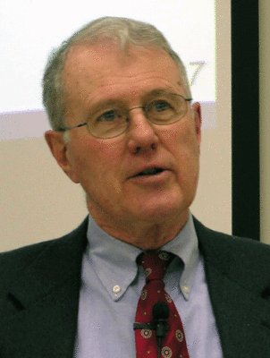
Foundations of Biblical Prophecy
Lecture 3 Companies of Prophets
Dr. Robert Vannoy
ReNarrated by Ted Hildebrandt
© 2023 Robert Vannoy & Ted Hildebrandt

Slide 2
Foundations of Biblical Prophecy
F. 2. Companies of prophets called “Sons of the Prophets”
  a. “Son” as a member of a group
    1. Example: Neh. 12:28
    2. Example: Ps. 18:44
    3. Example: Ps. 72:4
    4. Example 2 Chr. 25:13

Slide 3
Foundations of Biblical Prophecy
F. 3. The Term or Expression “School of the Prophets”
  a. Not support for a “school”
  b. Samuel as a leader – 1 Sam 19
  c. Elisha as a leader – 2 Kings 4
  d. Not an ancient seminary-like training program
  e. Place of the companies of the Prophets

Slide 4
Foundations of Biblical Prophecy
F. 4. Companies of the Prophets Apparently Lived in their Own
Communities
  Housing and Eating - 2 Kings 6
F. 5. The Degeneration of the Prophetic Function within the
companies
  a. Elisha – 2 Kings 4
  b. Royal Court Prophets – 1 Kings 22
F. 6. The Canonical Prophets are Distinguished from These
Companies – Amos 7 Discussion

Slide 5
Foundations of Biblical Prophecy
G. The Canonical Prophets were Writing Prophets
  1. Writing Prophets
  2. “Canonical Prophets”

Slide 6
Foundations of Biblical Prophecy
II. The Prophetic Nomenclature
  A. Man of God
  B. Servant of the LORD
  C. The Messenger of the LORD
  D. Nabi [Prophet]
    1. Etymology of Nabi [prophet]
    2. Usage of Nabi [prophet]
Video based on audio from Dr. Vannoy’s class at Biblical Theological Seminary. It was renarrated because the original audio was scratchy and turned into video by Ted Hildebrandt for Biblicalelearning.org.

