Slide 1
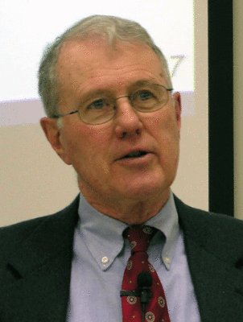

Foundations of Biblical Prophecy
Lecture 2 Prophetic Awareness and History of the Prophets
Dr. Robert Vannoy
ReNarrated by Ted Hildebrandt
© 2023 Robert Vannoy & Ted Hildebrandt

Slide 2
Foundations of Biblical Prophecy
C. 3. There is a distinction between a prophet’s own word and the Word of God which they spoke
  a. Example: 2 Sam 7 – David and Nathan
  b. Example: 1 Sam 16 – Samuel’s anointing of David
  c. Example: Jonah
  d. Example: Jeremiah 27-28 Jeremiah and Hananiah
  e. Example: 1 Kings 13 The Man of God out of Judah and the
  Old Prophet
  f. Conclusion

Slide 3
Foundations of Biblical Prophecy
D. The Phenomenon of Israel’s prophets is as old as the history of Israel Itself
  1. History of Israel and History of Prophets Coextensive
    a. Prophets of Old
    b. Prophetesses
    c. Companies/bands of Prophets
      1. 1 Sam 10 – Saul and the Company of Prophets
      2. 2 Kgs 2-4 Elisha and the Company of the prophets at Jericho, Bethel…
      3. 1 Sam. 19 Saul and the prophetic companies
      4. 1 Kgs 20 A prophet from the company of the prophets speaks for God
      5. Function of the companies of the prophets

Slide 4
Foundations of Biblical Prophecy
D. 2. Sons of the Prophets [bene hanebiim: בְנֵי־הַנְּבִיאִים ]
  a. The Various Meanings of the Term “son” (ben) etc.
Video based on audio from Dr. Vannoy’s class at Biblical Theological Seminary. It was renarrated because the original audio was scratchy and turned into video by Ted Hildebrandt for Biblicalelearning.org.

